Slide 1
1. Executive Project Overview
TPM PROJECT
Project: AI-Powered Customer Support Platform managed through Jira.
Primary environment: AI TPM Scrum Lab (ATSL); supporting Cloud/DevOps Kanban environment: KAN.
Objective: demonstrate practical TPM ownership from backlog to sprint execution, dependency management, risk escalation, reporting and executive dashboarding.
Evidence is backed by Jira screenshots captured during the hands-on exercise.
AI TPM / Jira Delivery Project • Prepared by Mahesh Zade
1

Slide 2
2. Business Problem & Product Context
TPM PROJECT
Cloud support teams receive tickets requiring classification, priority prediction, routing and sentiment analysis.
The TPM translates product intent into measurable delivery increments.
Delivery focus: AI-powered support-ticket triage while maintaining visibility of dependencies and delivery risks.
Success means transparent scope, accountable ownership, measurable progress and controlled delivery risk.
AI TPM / Jira Delivery Project • Prepared by Mahesh Zade
2

Slide 3
3. Jira Operating Model
TPM PROJECT
Epic / parent capability → user story → acceptance criteria → subtasks → sprint → delivery evidence.
Status flow: To Do → In Progress → Done.
Dependencies are explicitly linked rather than kept only in comments.
Risks have an owner, impact, mitigation and checkpoint.
Dashboards convert work-item data into stakeholder visibility.
AI TPM / Jira Delivery Project • Prepared by Mahesh Zade
3

Slide 4
4. Cloud/DevOps Work Breakdown
TPM PROJECT
KAN-4: provision EC2 and S3 infrastructure for a customer application.
Subtasks: KAN-6 EC2, KAN-7 S3, KAN-8 security group, KAN-9 documentation.
KAN-6 blocks KAN-8, demonstrating a real implementation dependency.
Ownership, priority, labels and status are maintained in Jira.
AI TPM / Jira Delivery Project • Prepared by Mahesh Zade
4

Slide 5
5. AI Scrum Backlog
TPM PROJECT
ATSL-1: AI ticket classification — 5 story points — completed.
ATSL-2: AI ticket priority prediction — 3 story points — dependency on prediction API.
ATSL-3: AI ticket routing — 5 story points — decomposed into four implementation subtasks.
ATSL-4 sentiment analysis was retained outside the initial sprint scope.
AI TPM / Jira Delivery Project • Prepared by Mahesh Zade
5

Slide 6
6. User Story Quality
TPM PROJECT
User stories use the format: As a [role], I want [capability], so that [outcome].
Acceptance criteria define observable behavior rather than implementation details.
Example: AI identifies Critical/High/Medium/Low priority, provides a recommendation, allows manager review and records the result.
This gives Engineering and QA a shared definition of done.
AI TPM / Jira Delivery Project • Prepared by Mahesh Zade
6

Slide 7
7. Sprint Planning
TPM PROJECT
Sprint planning selected a focused set of AI support-ticket capabilities.
Sprint 1 goal: deliver core classification, priority prediction and automatic routing.
Initial commitment: 13 story points.
Sprint 2 continued priority prediction and routing while actively managing API and routing-rule dependencies.
AI TPM / Jira Delivery Project • Prepared by Mahesh Zade
7

Slide 8
8. Sprint Execution & Flow
TPM PROJECT
Completed work moves to Done; active work remains visible in In Progress.
Subtasks expose implementation progress beneath the parent story.
Dependencies prevent downstream work from being treated as independently deliverable.
Status updates provide an audit trail for stakeholder communication.
AI TPM / Jira Delivery Project • Prepared by Mahesh Zade
8

Slide 9
9. Dependency Management
TPM PROJECT
ATSL-5 blocks ATSL-2 because the AI Prediction API may not be available on time.
ATSL-7 blocks ATSL-8 because routing logic depends on finalized routing rules and team mapping.
KAN-6 blocks KAN-8 for the Cloud/DevOps infrastructure flow.
TPM practice: identify → link → assess impact → assign owner → mitigate → checkpoint.
AI TPM / Jira Delivery Project • Prepared by Mahesh Zade
9

Slide 10
10. Risk Management
TPM PROJECT
ATSL-5 is a delivery risk with High impact and a documented owner.
Mitigation includes confirming API readiness, authentication, response format and using a mock API in parallel.
Checkpoint: confirm readiness and integration contract by the stated date.
Risk comments were used as structured TPM status updates rather than informal notes.
AI TPM / Jira Delivery Project • Prepared by Mahesh Zade
10

Slide 11
11. Escalation Pattern
TPM PROJECT
Risk statement: what may happen and why it matters.
Impact: identify the affected story, sprint or downstream capability.
Escalation: name the responsible engineering/team owner and the required decision.
Recovery plan: parallelize work, use a mock dependency, revise delivery sequencing or communicate a schedule impact.
Next checkpoint: define a concrete date or trigger.
AI TPM / Jira Delivery Project • Prepared by Mahesh Zade
11

Slide 12
12. JQL Fundamentals
TPM PROJECT
Status query: project = ATSL AND status = "In Progress".
Outstanding work: project = ATSL AND status != Done.
High priority: project = ATSL AND priority in (Highest, High).
My work: project = ATSL AND assignee = currentUser().
Dependency query: project = KAN AND workItemLinkType = "is blocked by".
AI TPM / Jira Delivery Project • Prepared by Mahesh Zade
12

Slide 13
13. Saved Filters
TPM PROJECT
TPM - AI Risks: project = ATSL AND labels = risk.
TPM - High Priority Open Work: saved query for high-priority unresolved delivery work.
TPM - KAN Blockers: dependency query for KAN blocked work.
Saved filters provide reusable data sources for dashboards and stakeholder views.
AI TPM / Jira Delivery Project • Prepared by Mahesh Zade
13

Slide 14
14. Burndown Interpretation
TPM PROJECT
Burndown shows remaining story points over the sprint timeline.
The chart distinguishes actual remaining work from the ideal guideline.
A TPM uses deviations to ask: is scope changing, is delivery slower, or are dependencies constraining throughput?
Burndown is a signal for intervention, not a substitute for root-cause analysis.
AI TPM / Jira Delivery Project • Prepared by Mahesh Zade
14

Slide 15
15. Sprint Report Interpretation
TPM PROJECT
Sprint Report separates completed and not-completed work.
It exposes scope that moved forward and work that remained in progress.
TPM discussion should connect incomplete items to dependency, capacity, scope or quality reasons.
The report is useful for sprint review and retrospective preparation.
AI TPM / Jira Delivery Project • Prepared by Mahesh Zade
15

Slide 16
16. Cumulative Flow & Status Analysis
TPM PROJECT
Cumulative Flow visualizes how work accumulates across statuses.
Growing In Progress work can indicate a bottleneck.
Stable flow requires balanced intake, execution and completion.
Status distribution on the final dashboard gives an executive snapshot.
AI TPM / Jira Delivery Project • Prepared by Mahesh Zade
16

Slide 17
17. Dashboard Design
TPM PROJECT
Dashboard: AI TPM Delivery Dashboard.
Core views: status distribution, high-priority open work, AI risks, assigned work and KAN blockers.
The dashboard is designed around TPM questions: What is blocked? What is risky? What is urgent? What is progressing?
Only useful gadgets were retained to avoid dashboard noise.
AI TPM / Jira Delivery Project • Prepared by Mahesh Zade
17

Slide 18
18. Final Dashboard Snapshot
TPM PROJECT
Status chart: 10 total work items — 5 To Do, 3 In Progress, 2 Done.
TPM - High Priority Open Work surfaces the current risk item.
TPM - AI Risks surfaces ATSL-5.
TPM - KAN Blockers surfaces KAN-8.
Assigned to Me provides personal execution visibility.
AI TPM / Jira Delivery Project • Prepared by Mahesh Zade
18

Slide 19
19. TPM Metrics to Monitor
TPM PROJECT
Delivery: story points completed vs committed.
Flow: work in progress, cycle time and throughput.
Risk: number of open high-impact risks and age of critical dependencies.
Quality: acceptance criteria completion and reopened work.
Stakeholder health: decisions pending, escalations and checkpoint adherence.
AI TPM / Jira Delivery Project • Prepared by Mahesh Zade
19

Slide 20
20. TPM Stakeholder Communication Framework
TPM PROJECT
Executive: outcome, delivery health, top risk, decision required.
Product: scope, customer impact, priority and trade-offs.
Engineering: dependency, technical owner, integration contract and acceptance criteria.
Support/Operations: readiness, runbook, incident impact and handoff.
AI TPM / Jira Delivery Project • Prepared by Mahesh Zade
20

Slide 21
21. TPM Question: How do you manage a blocked story?
TPM PROJECT
Answer: I first make the dependency explicit in Jira, identify the upstream owner and quantify impact on scope, milestone and downstream work.
I then agree a mitigation such as a mock interface, parallel development or resequencing.
I add a checkpoint and communicate the expected impact to stakeholders.
I only remove the blocker when the dependency is validated, not merely when someone says it is ready.
AI TPM / Jira Delivery Project • Prepared by Mahesh Zade
21

Slide 22
22. TPM Question: How do you prioritize work?
TPM PROJECT
Answer: I combine customer impact, business value, risk reduction, urgency, dependencies and engineering effort.
I make the prioritization criteria explicit and validate trade-offs with Product and Engineering.
For AI products, I also consider data readiness, model quality, safety, latency and integration dependencies.
The output is a transparent ordered backlog rather than a priority based only on opinion.
AI TPM / Jira Delivery Project • Prepared by Mahesh Zade
22

Slide 23
23. TPM Question: How do you handle an API dependency?
TPM PROJECT
Answer: I define the interface contract early: authentication, request/response schema, error handling, latency and availability expectations.
I identify the provider and consumer owners.
I use mocks or stubs to avoid blocking parallel development where feasible.
I track readiness as a dependency with a date and escalation path.
AI TPM / Jira Delivery Project • Prepared by Mahesh Zade
23

Slide 24
24. TPM Question: How do you run a sprint?
TPM PROJECT
Answer: Start with a clear sprint goal, prioritized backlog, capacity check and acceptance criteria.
During execution, monitor flow, blockers, risks and scope changes daily.
Use burndown/status reports for evidence and escalate material deviations early.
Finish with review and retrospective, then carry forward only justified incomplete work.
AI TPM / Jira Delivery Project • Prepared by Mahesh Zade
24

Slide 25
25. TPM Question: How do you report project status to executives?
TPM PROJECT
Answer: Use a concise RAG-style narrative: outcome, progress, top risks, decisions needed and next milestone.
Lead with business impact rather than Jira mechanics.
Use dashboard evidence to support the message.
Never hide uncertainty; state the owner, mitigation and next checkpoint.
AI TPM / Jira Delivery Project • Prepared by Mahesh Zade
25

Slide 26
26. TPM Question: What is the difference between a risk and an issue?
TPM PROJECT
Answer: A risk is a potential future event that may affect delivery; an issue is an active problem already affecting delivery.
Example risk: API may not be available by the integration date.
Example issue: the API is unavailable today and the sprint task is blocked.
Both need ownership, impact assessment and a response plan.
AI TPM / Jira Delivery Project • Prepared by Mahesh Zade
26

Slide 27
27. TPM Question: How do you manage scope creep?
TPM PROJECT
Answer: Make scope changes visible, assess impact on sprint goal and capacity, and obtain an explicit decision.
If new scope enters, either capacity or existing scope must change.
Use Jira history and sprint reports to preserve traceability.
Do not allow silent scope expansion.
AI TPM / Jira Delivery Project • Prepared by Mahesh Zade
27

Slide 28
28. TPM Question: What makes a good acceptance criterion?
TPM PROJECT
Answer: It is observable, testable and unambiguous.
It describes expected behavior and outcome, not a specific implementation unless implementation is itself a requirement.
It should support QA validation and stakeholder sign-off.
Good criteria reduce rework and disagreement over completion.
AI TPM / Jira Delivery Project • Prepared by Mahesh Zade
28

Slide 29
29. TPM Question: How do you manage AI product delivery?
TPM PROJECT
Answer: In addition to normal product delivery, I track data readiness, evaluation metrics, model/API dependencies, safety and monitoring.
I define measurable quality thresholds and test cases before production.
I separate model experimentation from production integration.
I plan rollback/fallback behavior for model or API failures.
AI TPM / Jira Delivery Project • Prepared by Mahesh Zade
29

Slide 30
30. TPM Question: How do you handle cross-team dependencies?
TPM PROJECT
Answer: Create a dependency map with upstream/downstream teams, owner, required artifact, due date, impact and escalation path.
Link the dependency in Jira where possible.
Use recurring checkpoints for critical dependencies.
Escalate based on impact and agreed thresholds, not emotion.
AI TPM / Jira Delivery Project • Prepared by Mahesh Zade
30

Slide 31
31. TPM Question: How do you measure sprint health?
TPM PROJECT
Answer: Combine goal progress, remaining work, flow, blockers, risk age, scope change and quality signals.
A sprint with many completed points can still be unhealthy if the critical path is blocked.
Use both quantitative charts and qualitative risk commentary.
The sprint goal remains the primary outcome measure.
AI TPM / Jira Delivery Project • Prepared by Mahesh Zade
31

Slide 32
32. TPM Question: What would you improve next?
TPM PROJECT
Answer: Add automation for risk aging, dependency reminders and stakeholder status summaries.
Integrate engineering delivery signals such as GitHub PRs, deployments and test results.
Add product metrics such as ticket deflection, routing accuracy and priority prediction precision/recall.
Use the dashboard as an operating mechanism, not only a reporting artifact.
AI TPM / Jira Delivery Project • Prepared by Mahesh Zade
32

Slide 33
33. Interview Story — Dependency Escalation
TPM PROJECT
Situation: AI priority prediction depended on an external API.
Task: protect sprint delivery while the API readiness was uncertain.
Action: documented the risk, linked it to ATSL-2, assigned the engineering owner, defined mock-API mitigation and checkpointed readiness.
Result: downstream delivery remained visible and actionable instead of becoming a surprise.
AI TPM / Jira Delivery Project • Prepared by Mahesh Zade
33

Slide 34
34. Interview Story — Delivery Dashboard
TPM PROJECT
Situation: delivery information was spread across stories, risks and blockers.
Task: create a single TPM view.
Action: created saved JQL filters and a dashboard for status, risks, high-priority work, assigned work and blockers.
Result: stakeholders can quickly identify delivery health, risks and intervention areas.
AI TPM / Jira Delivery Project • Prepared by Mahesh Zade
34

Slide 35
35. Final Project & Submission Checklist
TPM PROJECT
Jira practical work: completed.
Scrum execution, dependencies, risks, JQL, reports and dashboard: completed.
Evidence archive: 80 screenshots including final dashboard evidence.
70-page presentation: includes project explanation plus TPM interview questions and model answers.
GitHub-ready package: README, PPT, evidence, evidence index, TPM Q&A and submission checklist.
AI TPM / Jira Delivery Project • Prepared by Mahesh Zade
35

Slide 36
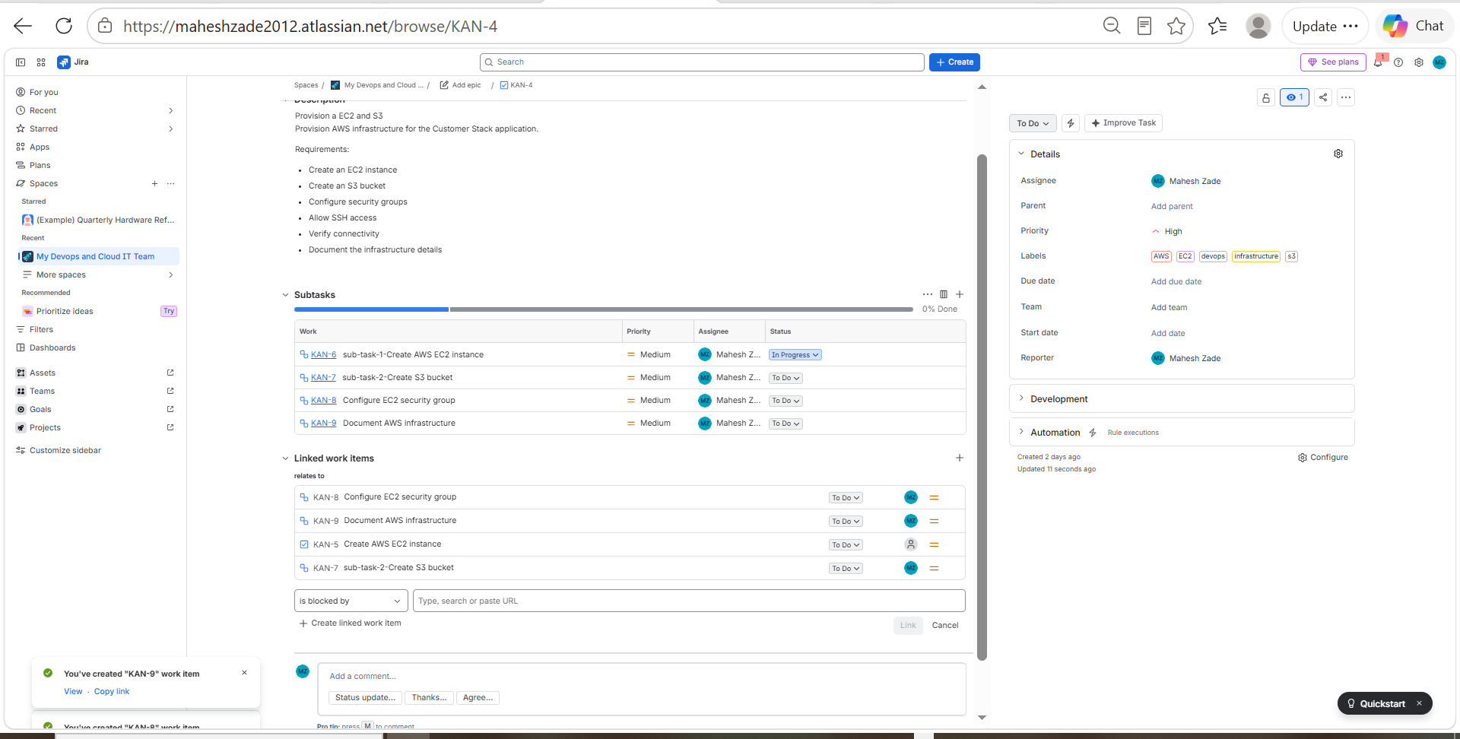
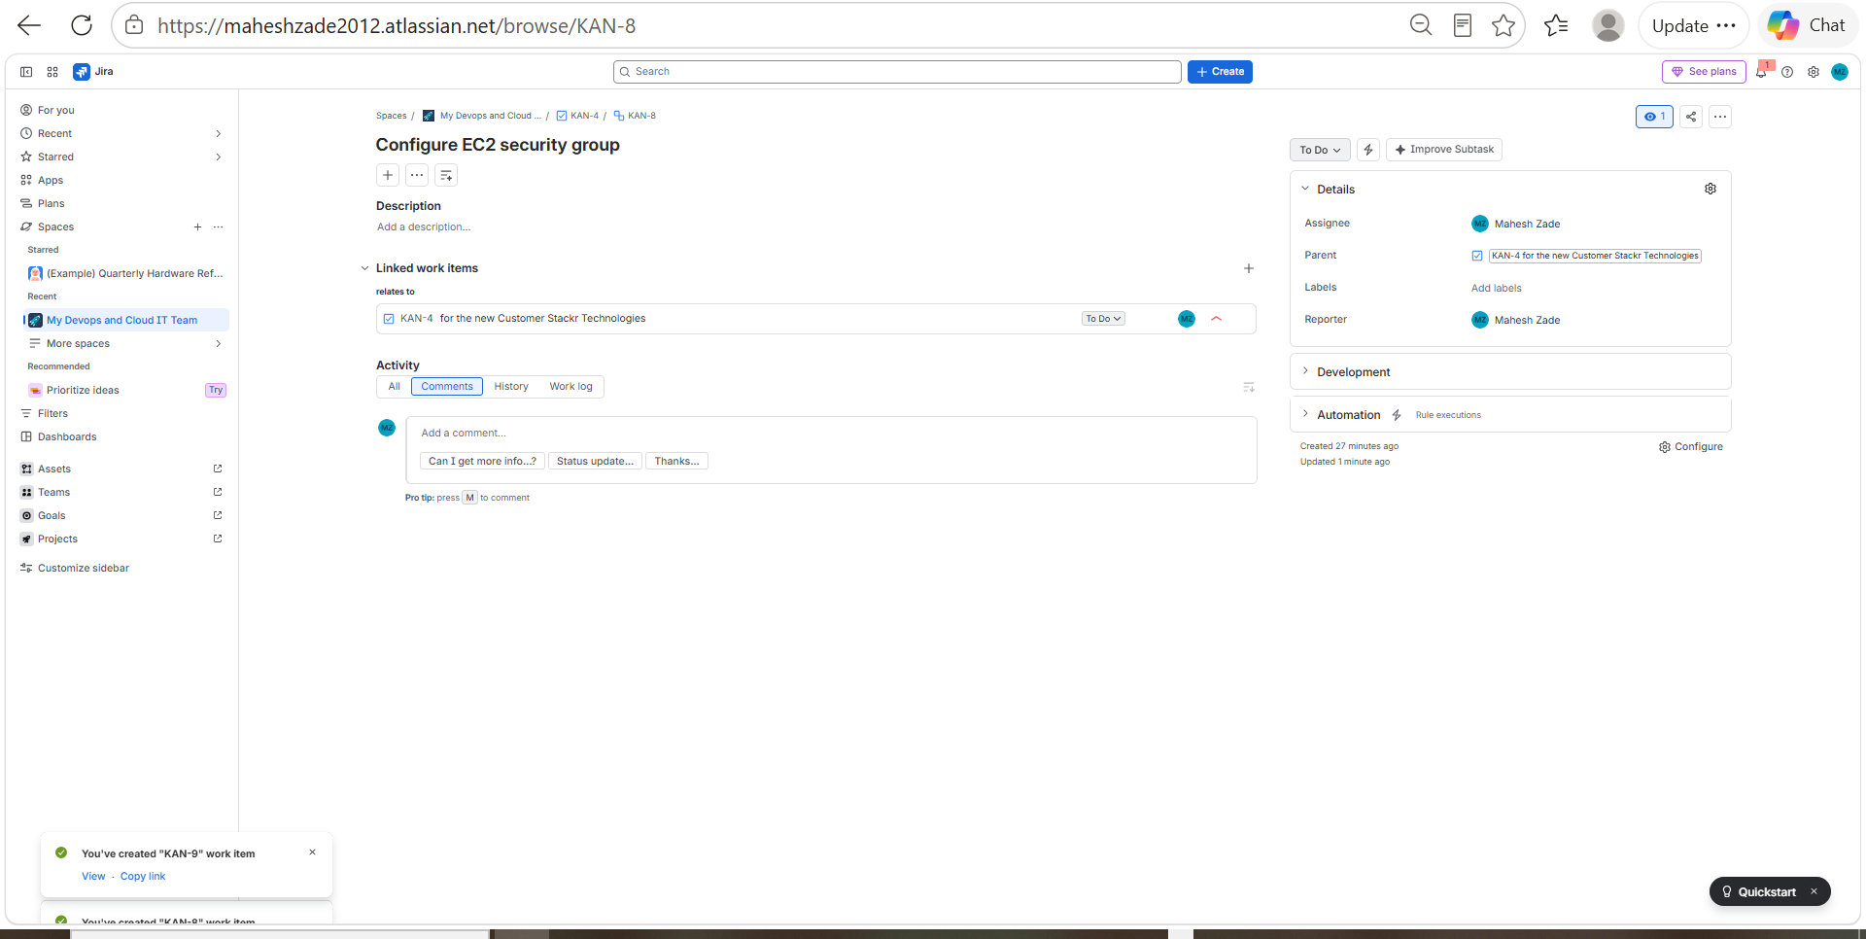
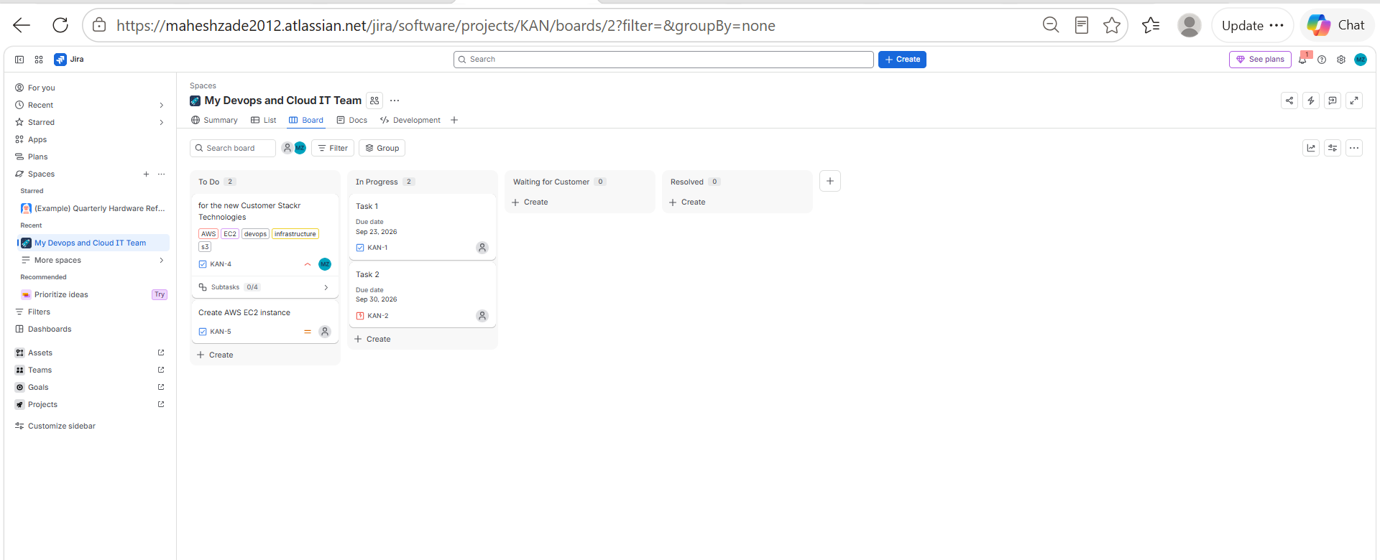
Evidence 01 — Jira Screenshot Archive
SCREENSHOT EVIDENCE
evidence_001
evidence_002
evidence_003
AI TPM / Jira Delivery Project • Prepared by Mahesh Zade
36

Slide 37
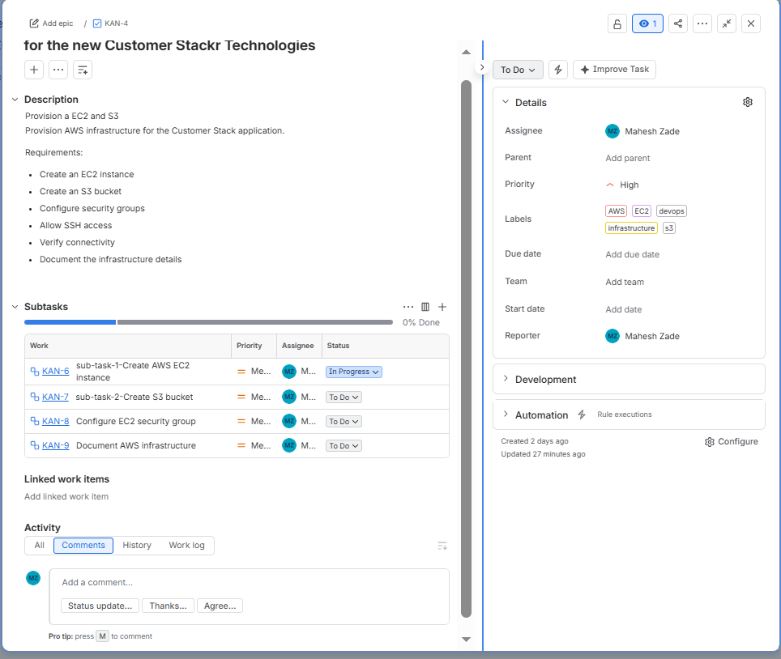
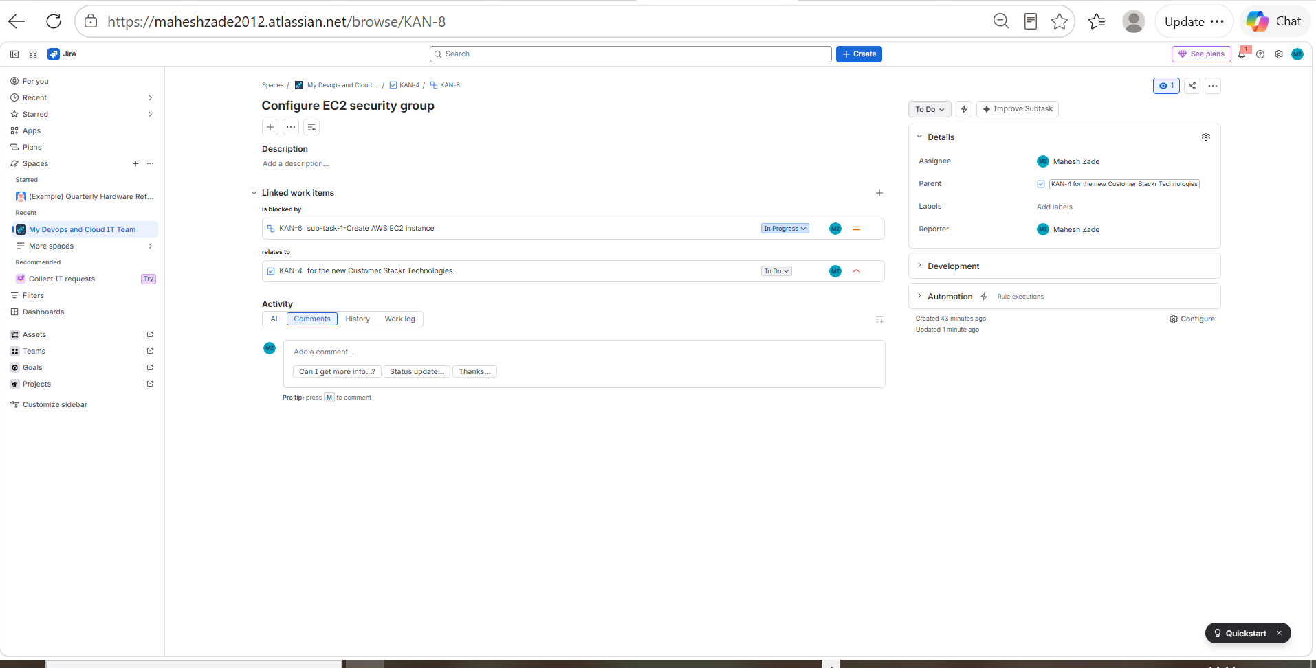
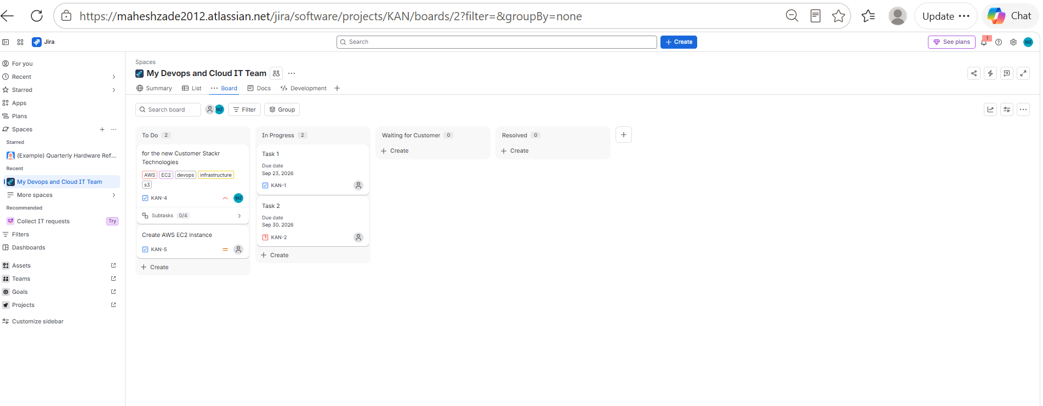
Evidence 02 — Jira Screenshot Archive
SCREENSHOT EVIDENCE
evidence_004
evidence_005
evidence_006
AI TPM / Jira Delivery Project • Prepared by Mahesh Zade
37

Slide 38
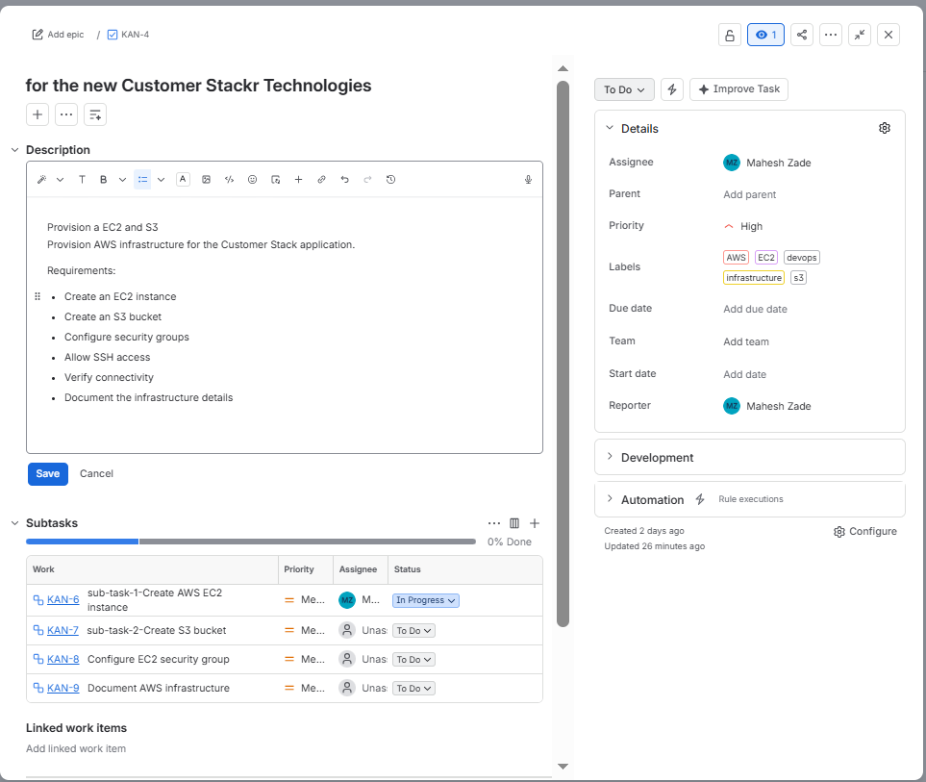
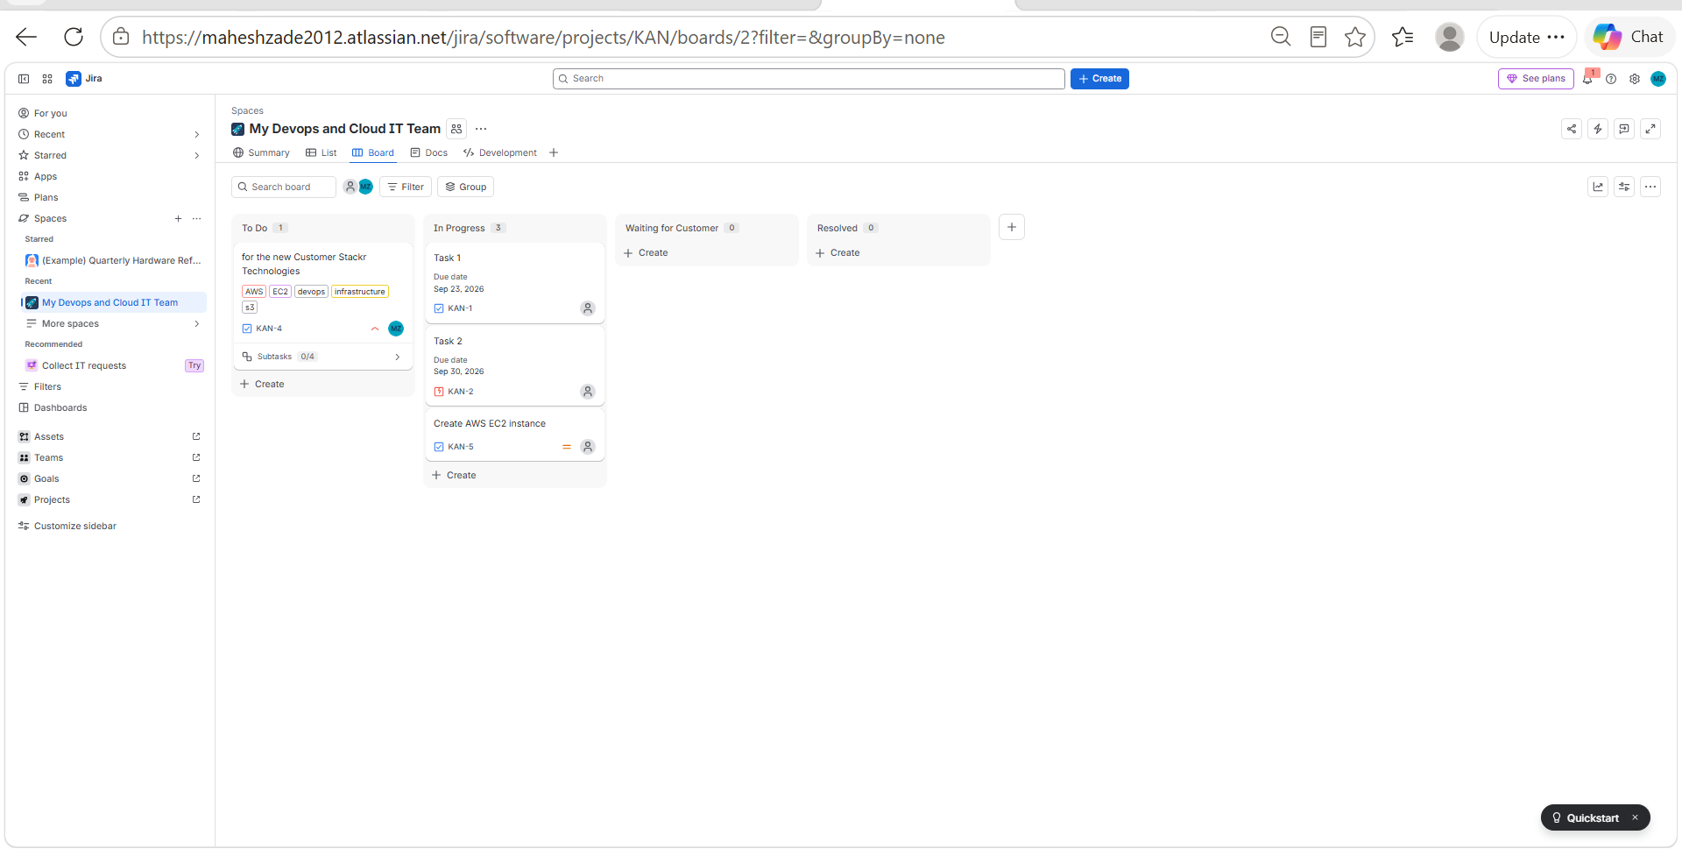
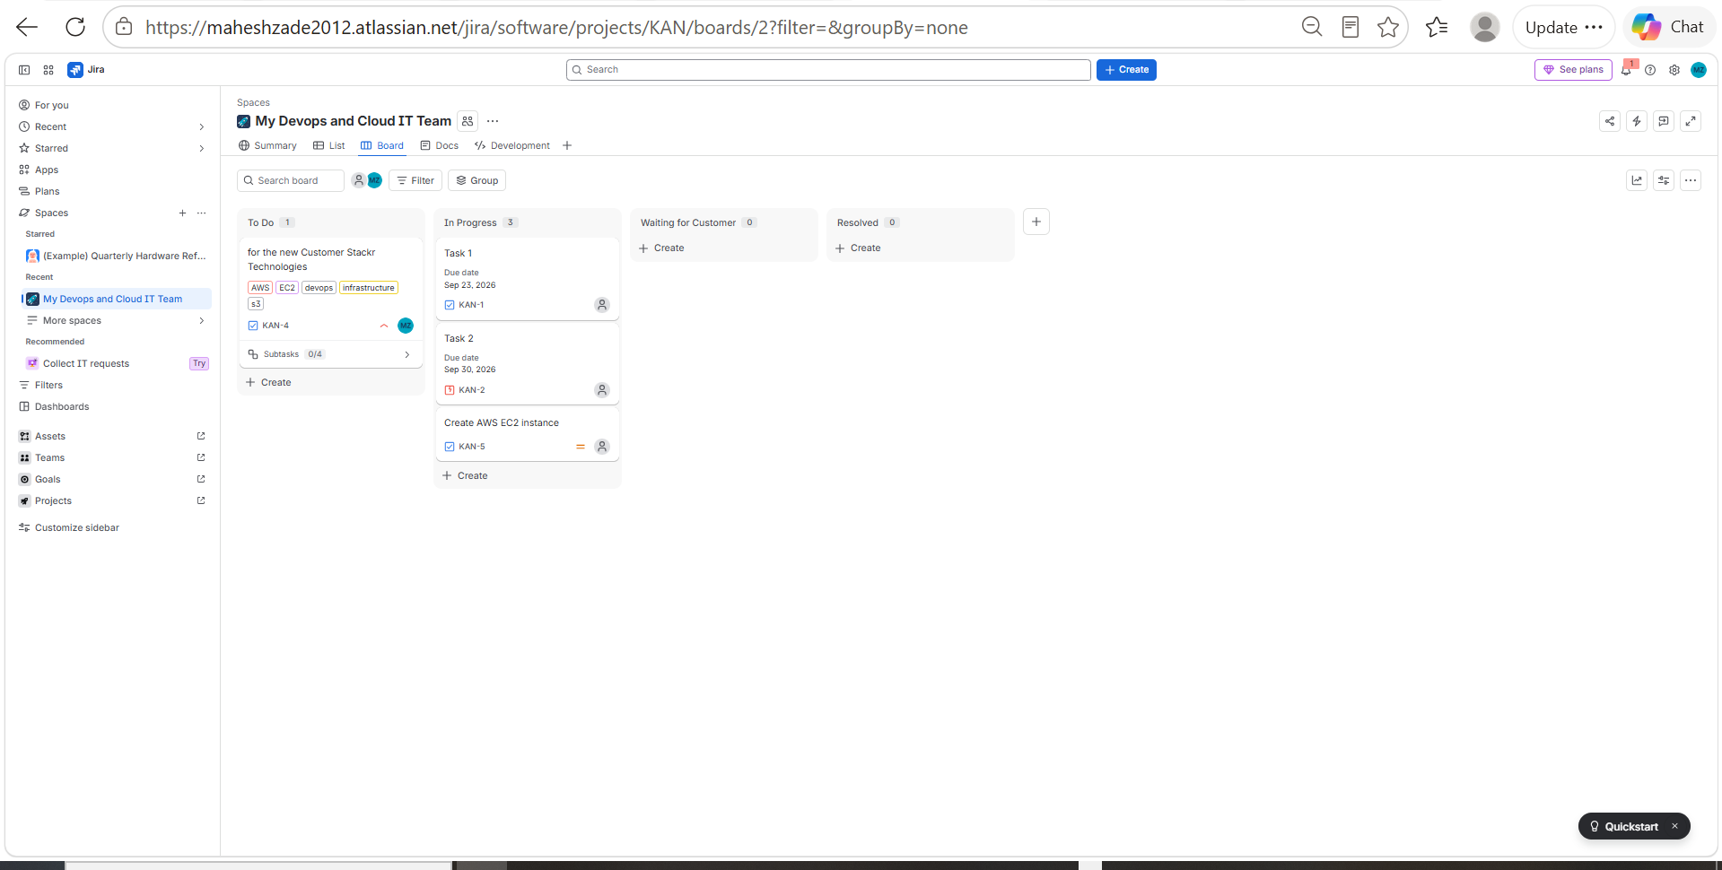
Evidence 03 — Jira Screenshot Archive
SCREENSHOT EVIDENCE
evidence_007
evidence_008
evidence_009
AI TPM / Jira Delivery Project • Prepared by Mahesh Zade
38

Slide 39
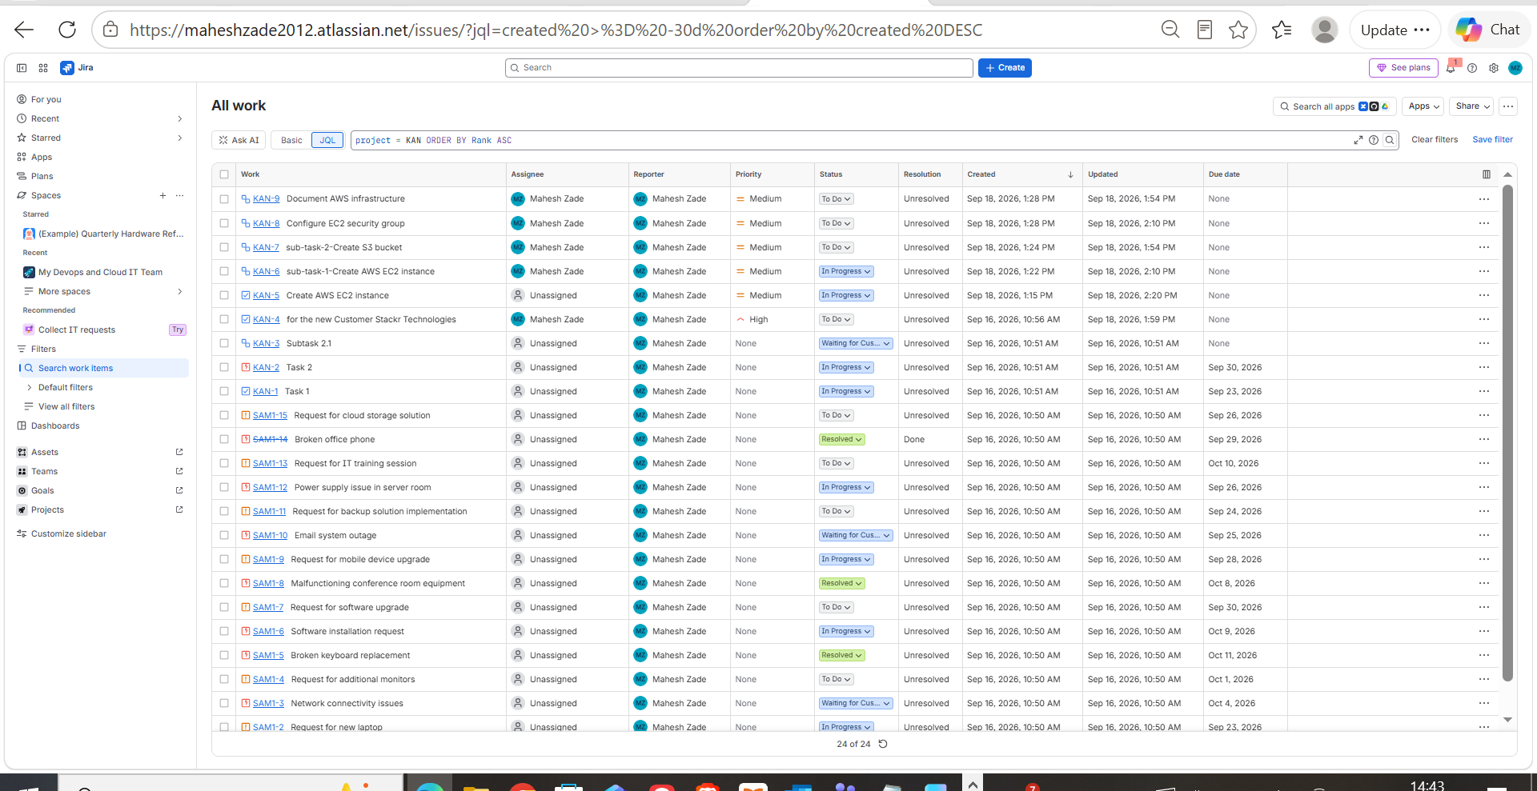
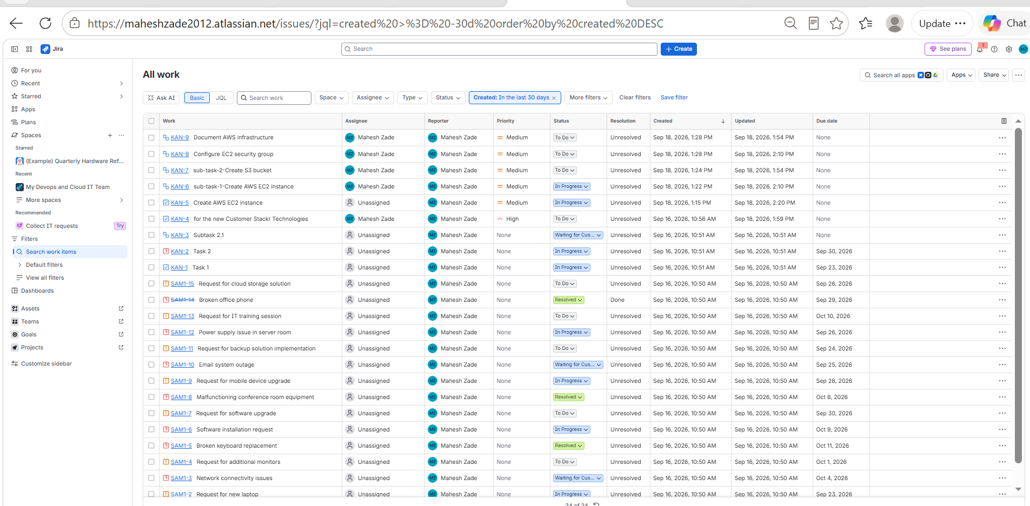
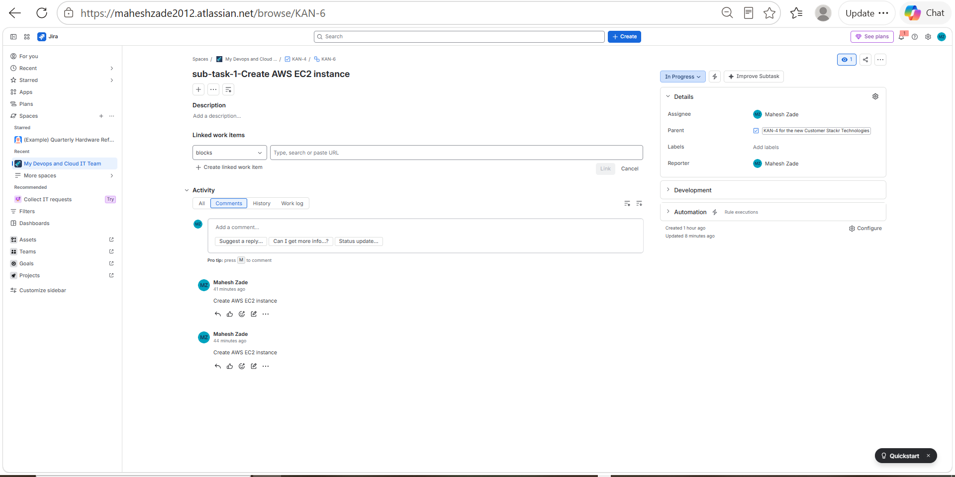
Evidence 04 — Jira Screenshot Archive
SCREENSHOT EVIDENCE
evidence_010
evidence_011
evidence_012
AI TPM / Jira Delivery Project • Prepared by Mahesh Zade
39

Slide 40
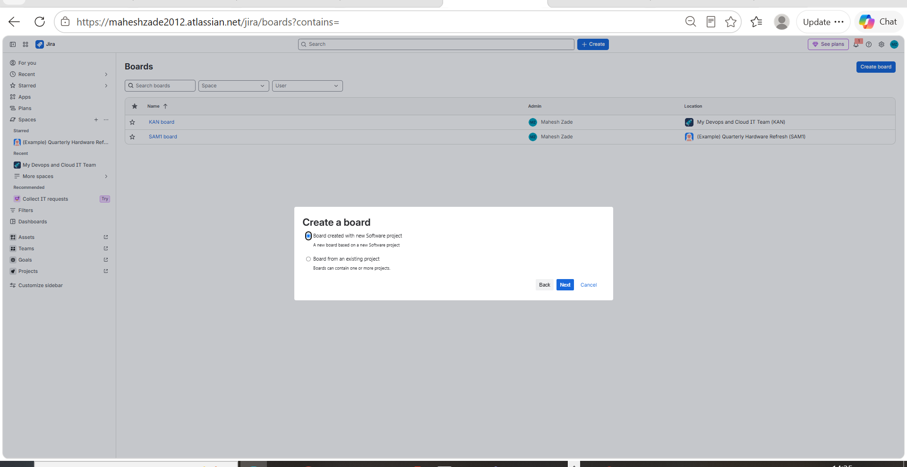
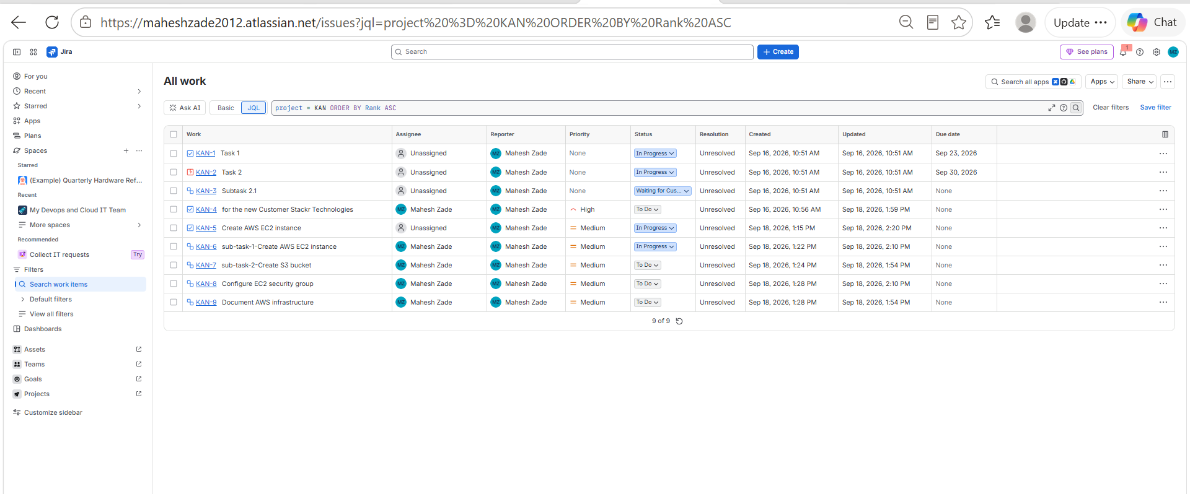
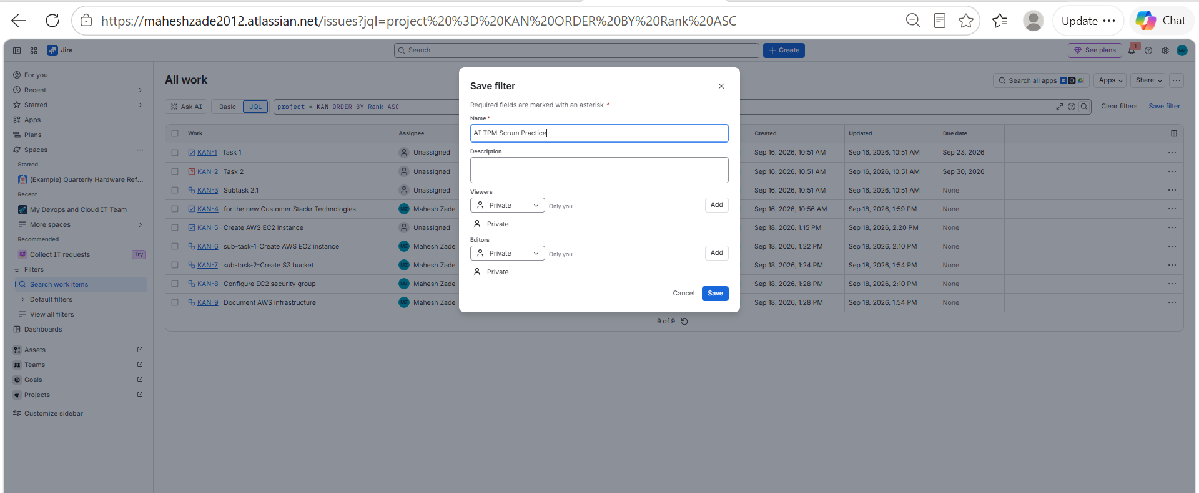
Evidence 05 — Jira Screenshot Archive
SCREENSHOT EVIDENCE
evidence_013
evidence_014
evidence_015
AI TPM / Jira Delivery Project • Prepared by Mahesh Zade
40

Slide 41
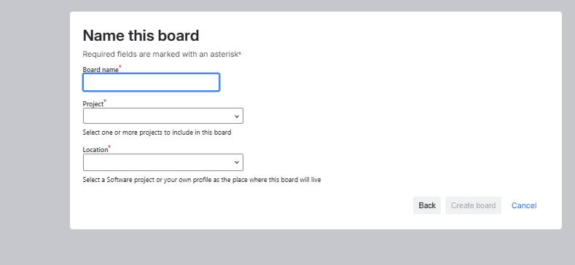
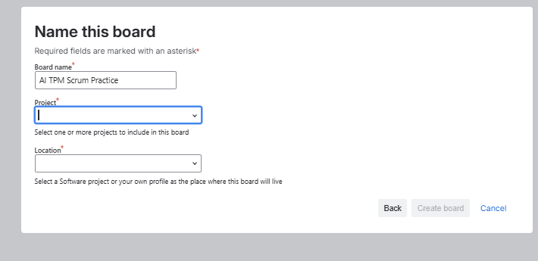
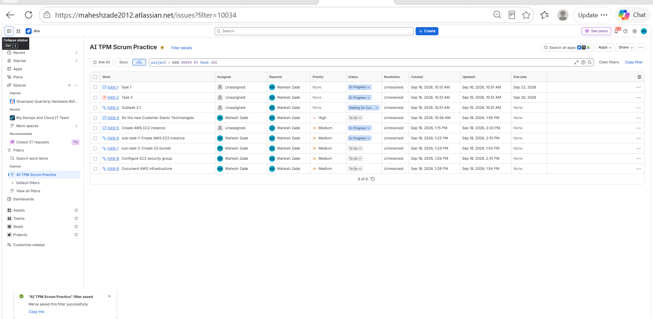
Evidence 06 — Jira Screenshot Archive
SCREENSHOT EVIDENCE
evidence_016
evidence_017
evidence_018
AI TPM / Jira Delivery Project • Prepared by Mahesh Zade
41

Slide 42
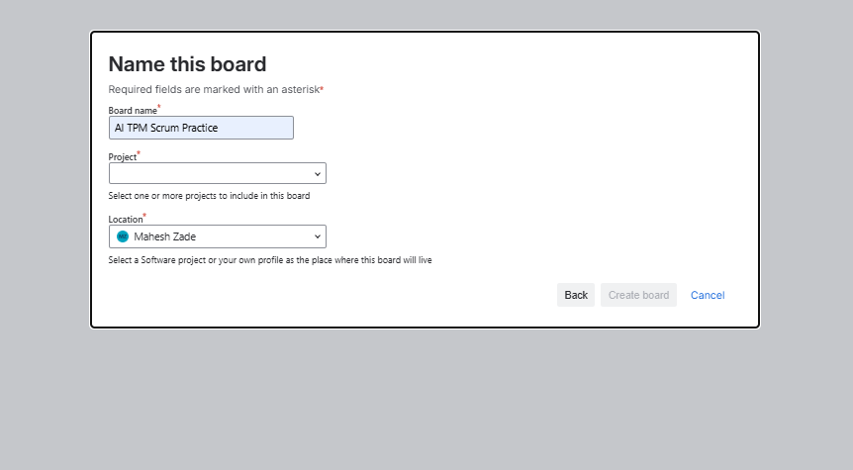
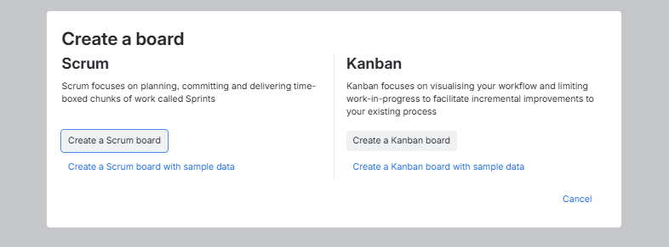
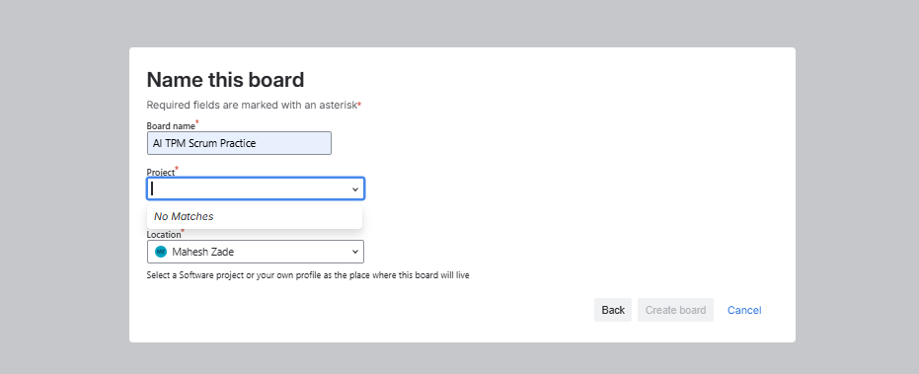
Evidence 07 — Jira Screenshot Archive
SCREENSHOT EVIDENCE
evidence_019
evidence_020
evidence_021
AI TPM / Jira Delivery Project • Prepared by Mahesh Zade
42

Slide 43
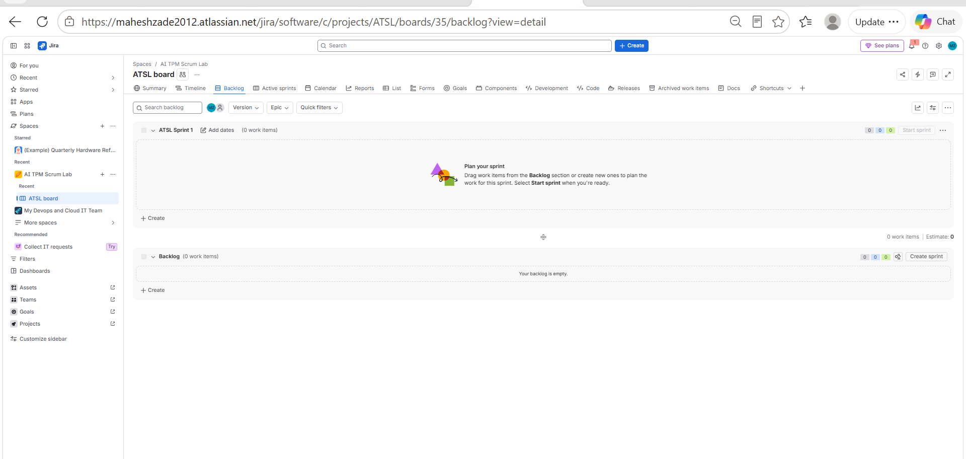
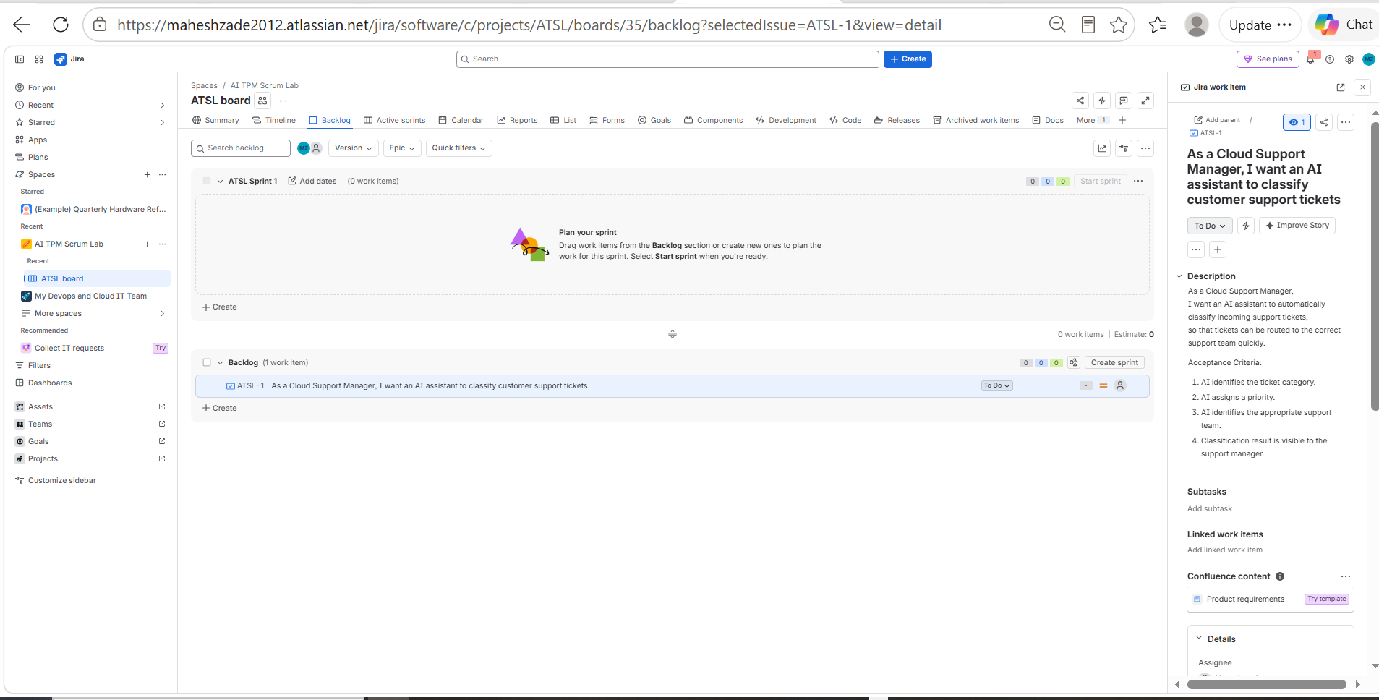
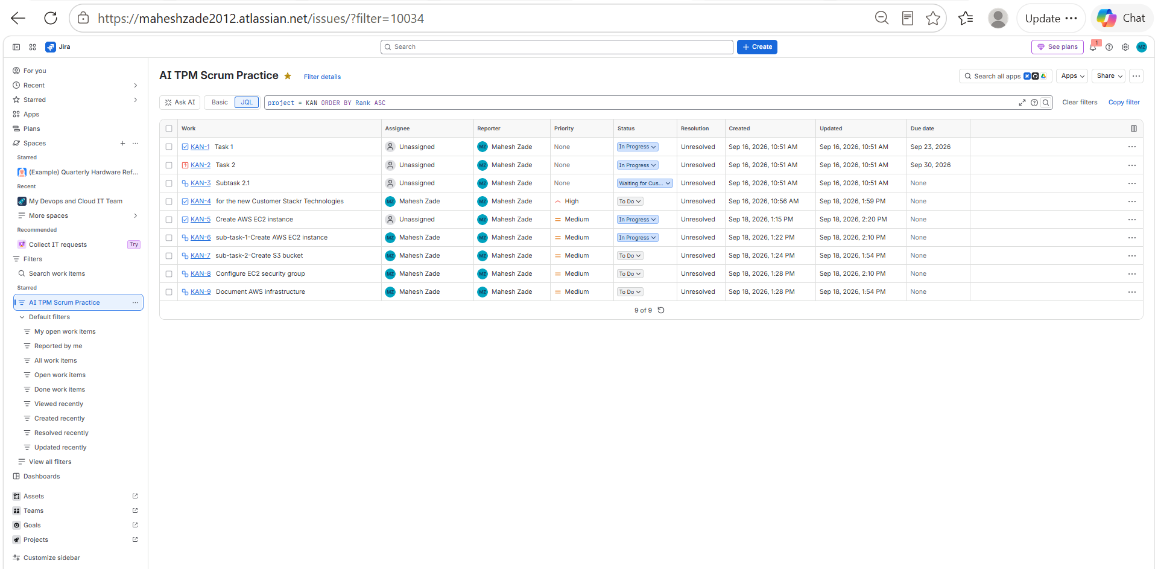
Evidence 08 — Jira Screenshot Archive
SCREENSHOT EVIDENCE
evidence_022
evidence_023
evidence_024
AI TPM / Jira Delivery Project • Prepared by Mahesh Zade
43

Slide 44
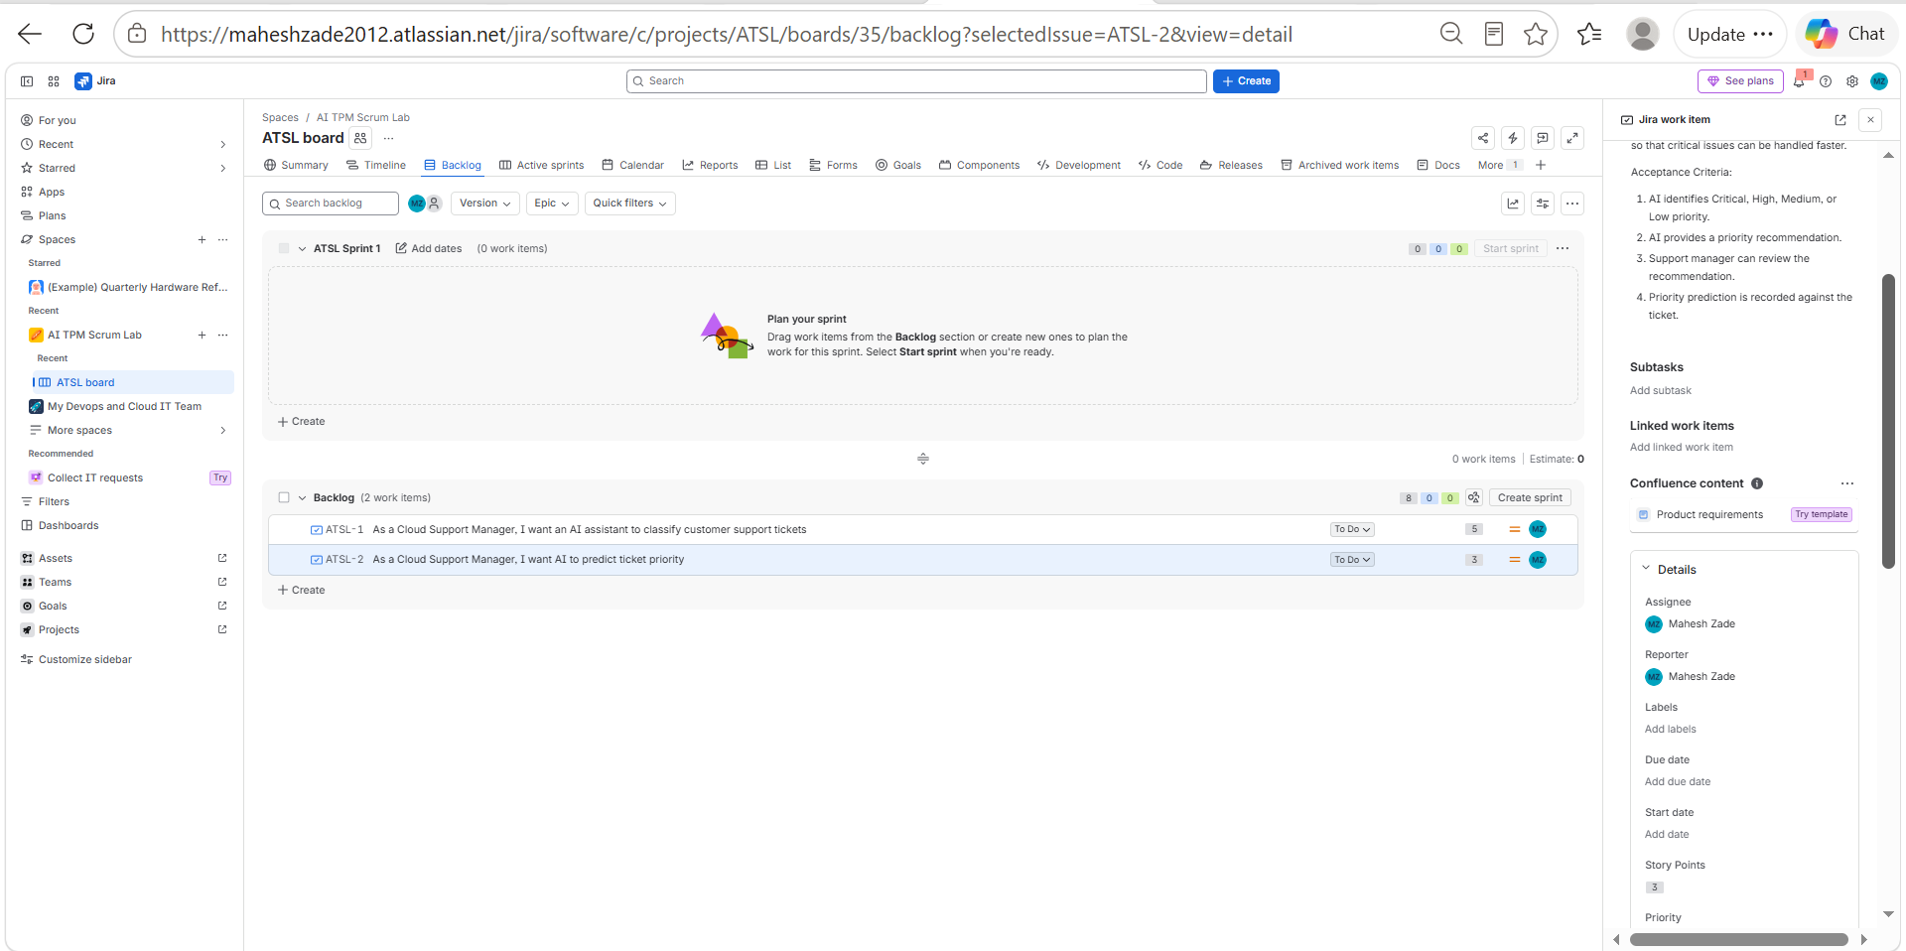
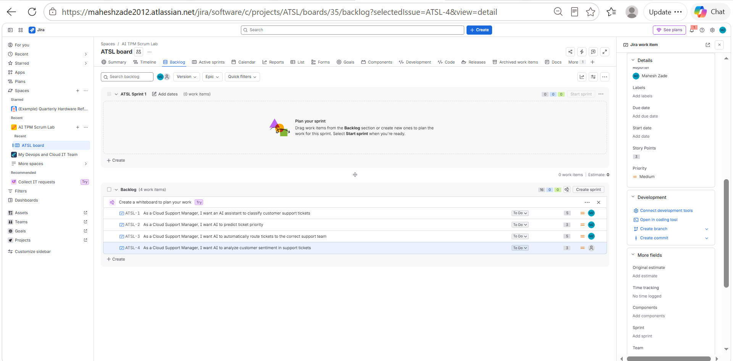
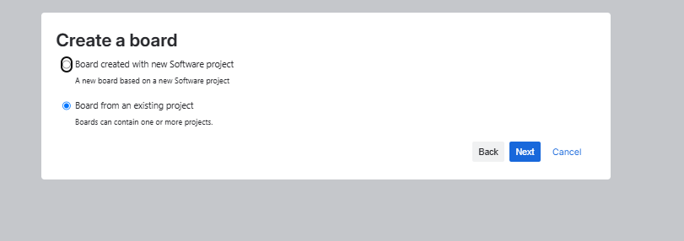
Evidence 09 — Jira Screenshot Archive
SCREENSHOT EVIDENCE
evidence_025
evidence_026
evidence_027
AI TPM / Jira Delivery Project • Prepared by Mahesh Zade
44

Slide 45
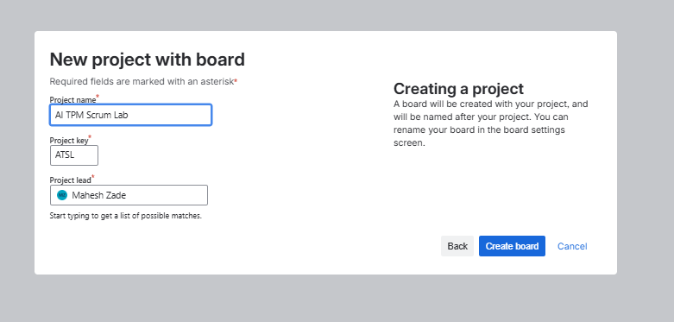
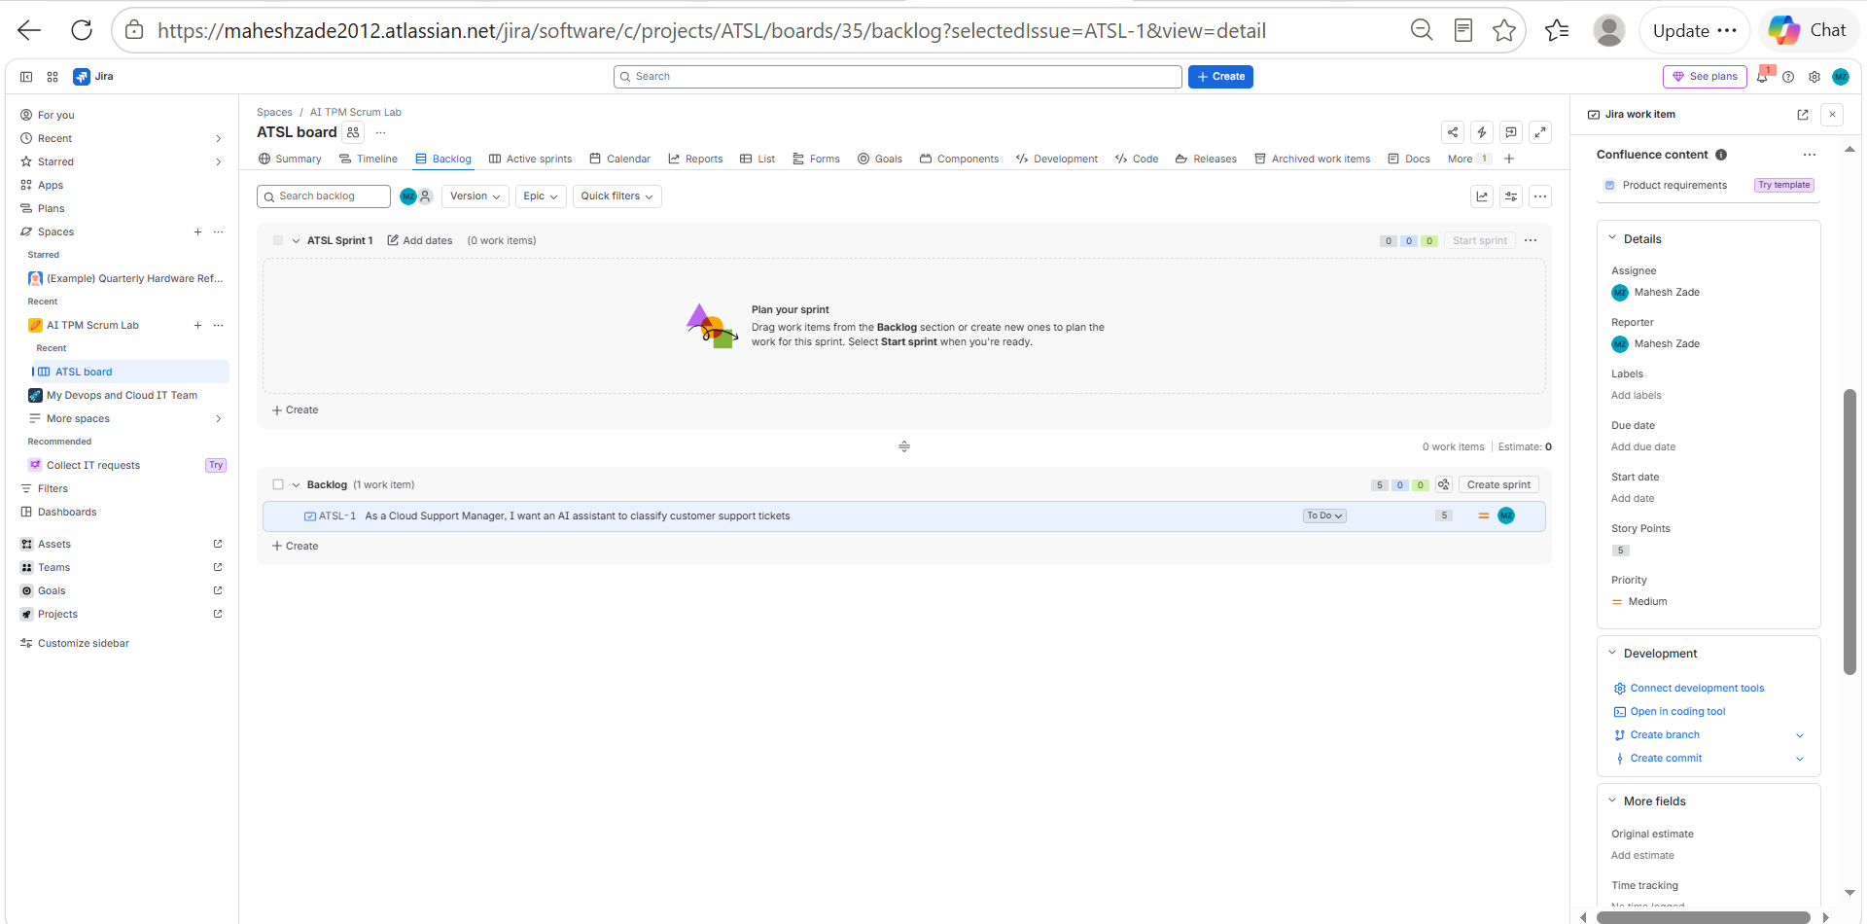
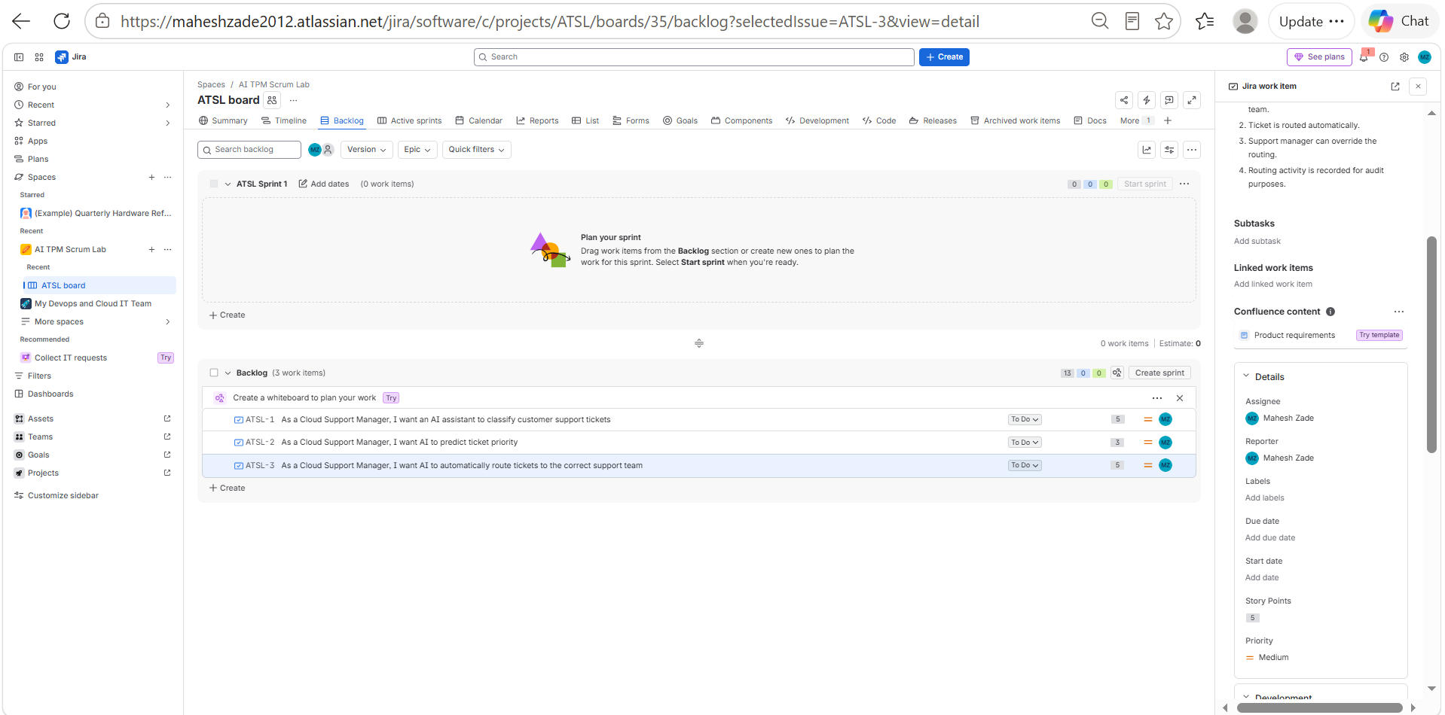
Evidence 10 — Jira Screenshot Archive
SCREENSHOT EVIDENCE
evidence_028
evidence_029
evidence_030
AI TPM / Jira Delivery Project • Prepared by Mahesh Zade
45

Slide 46
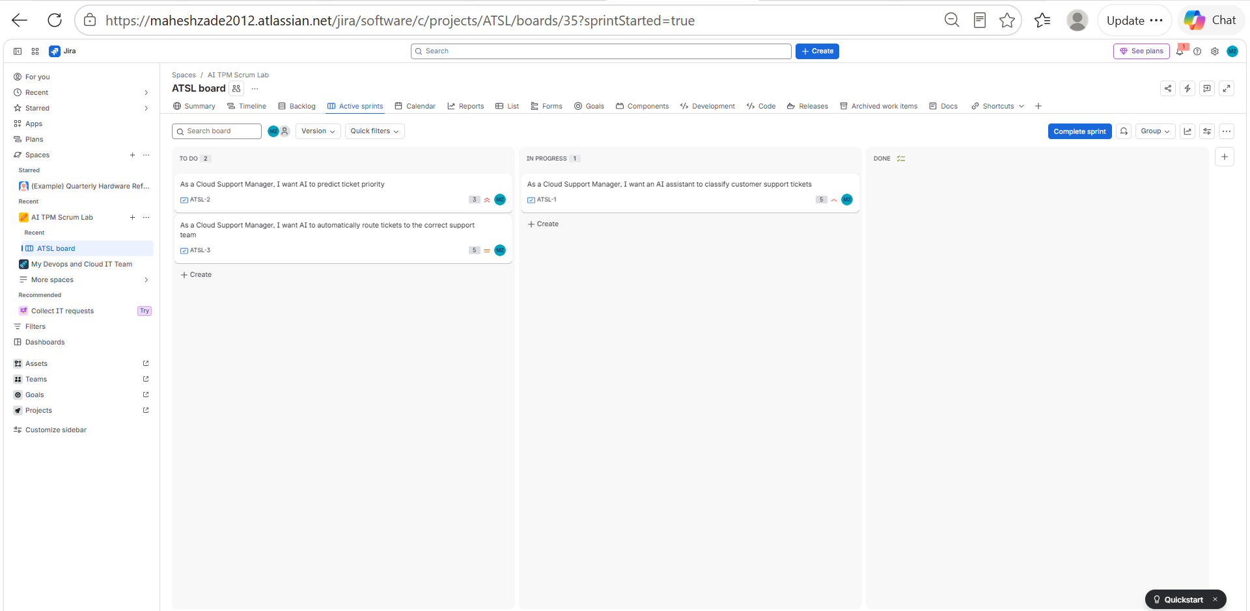
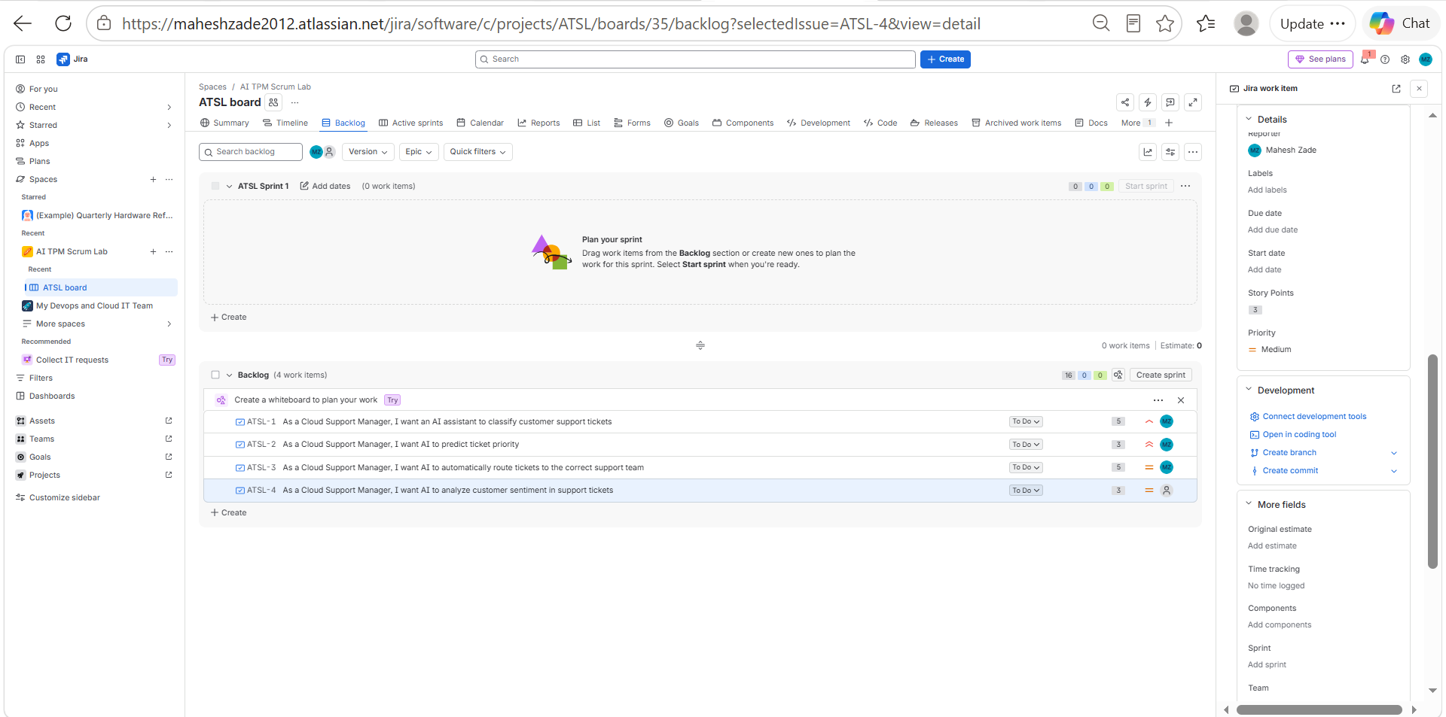
Evidence 11 — Jira Screenshot Archive
SCREENSHOT EVIDENCE
evidence_031
evidence_032
AI TPM / Jira Delivery Project • Prepared by Mahesh Zade
46

Slide 47
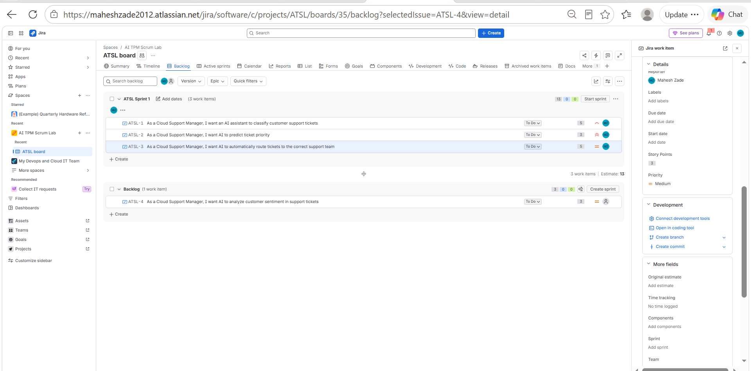
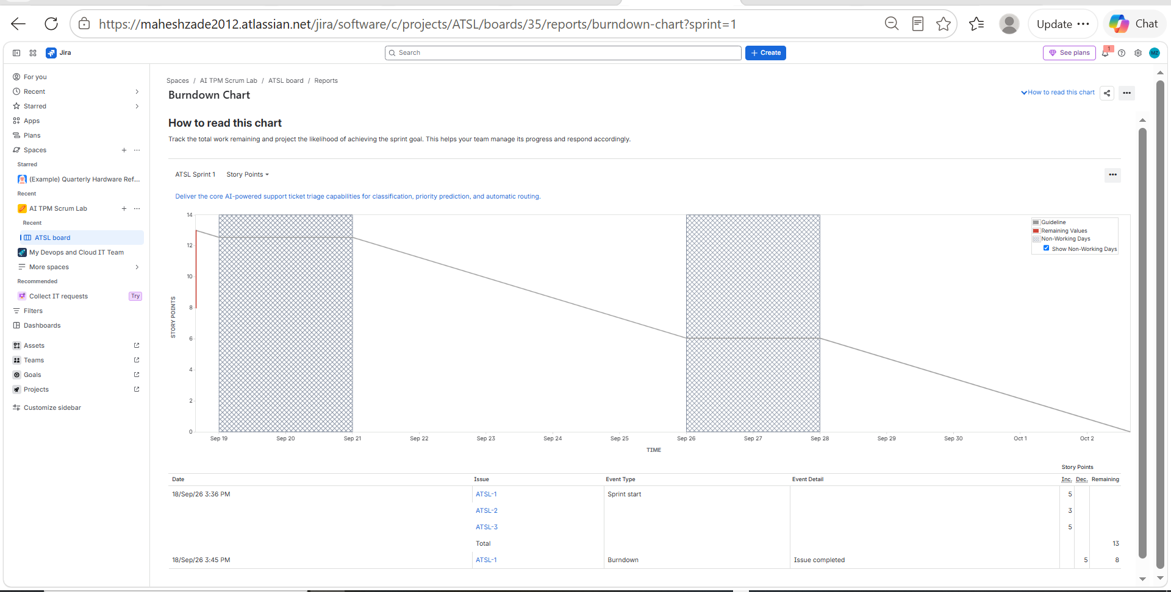
Evidence 12 — Jira Screenshot Archive
SCREENSHOT EVIDENCE
evidence_033
evidence_034
AI TPM / Jira Delivery Project • Prepared by Mahesh Zade
47

Slide 48
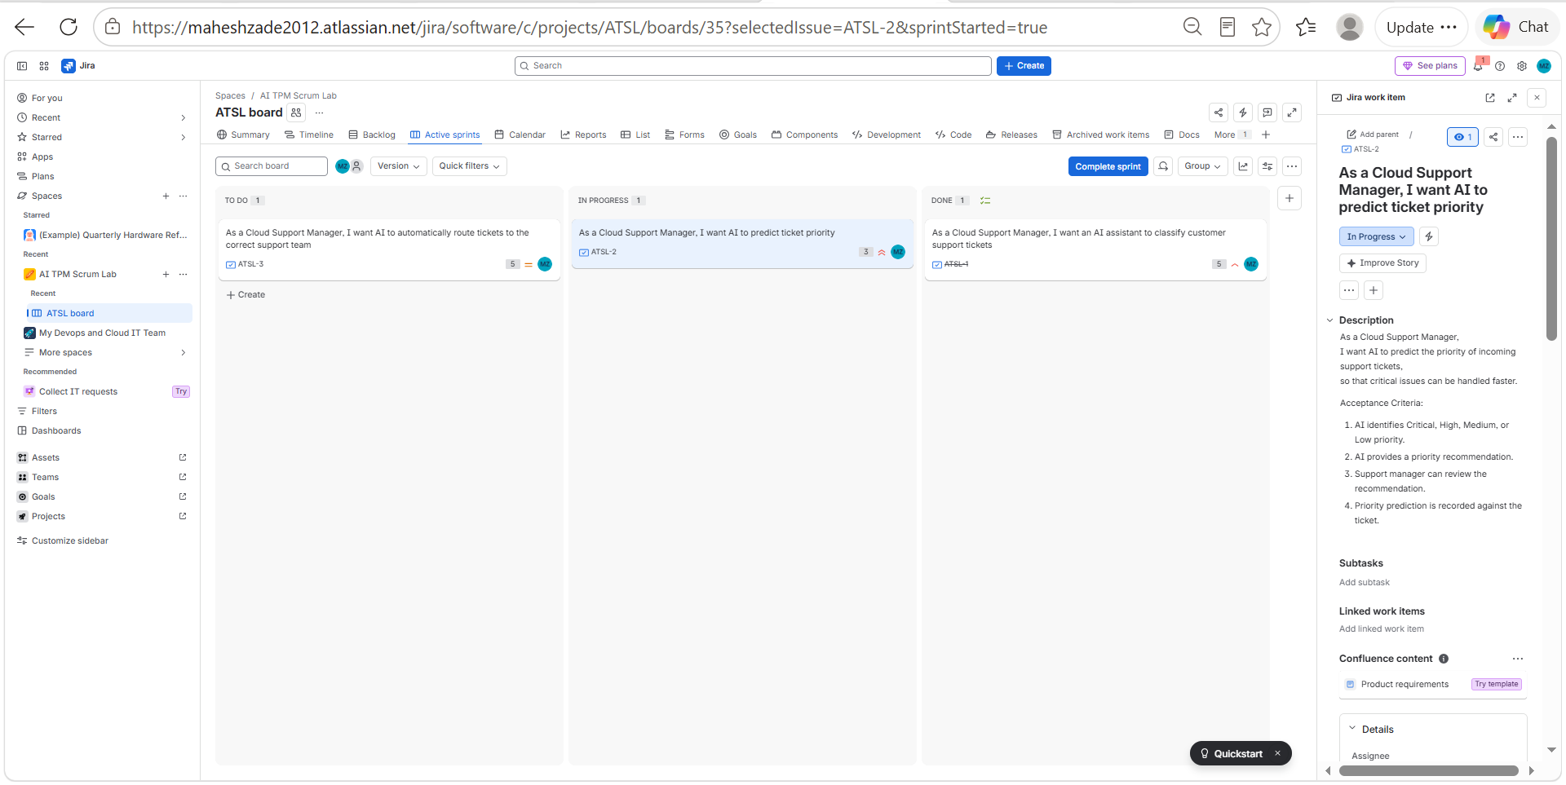
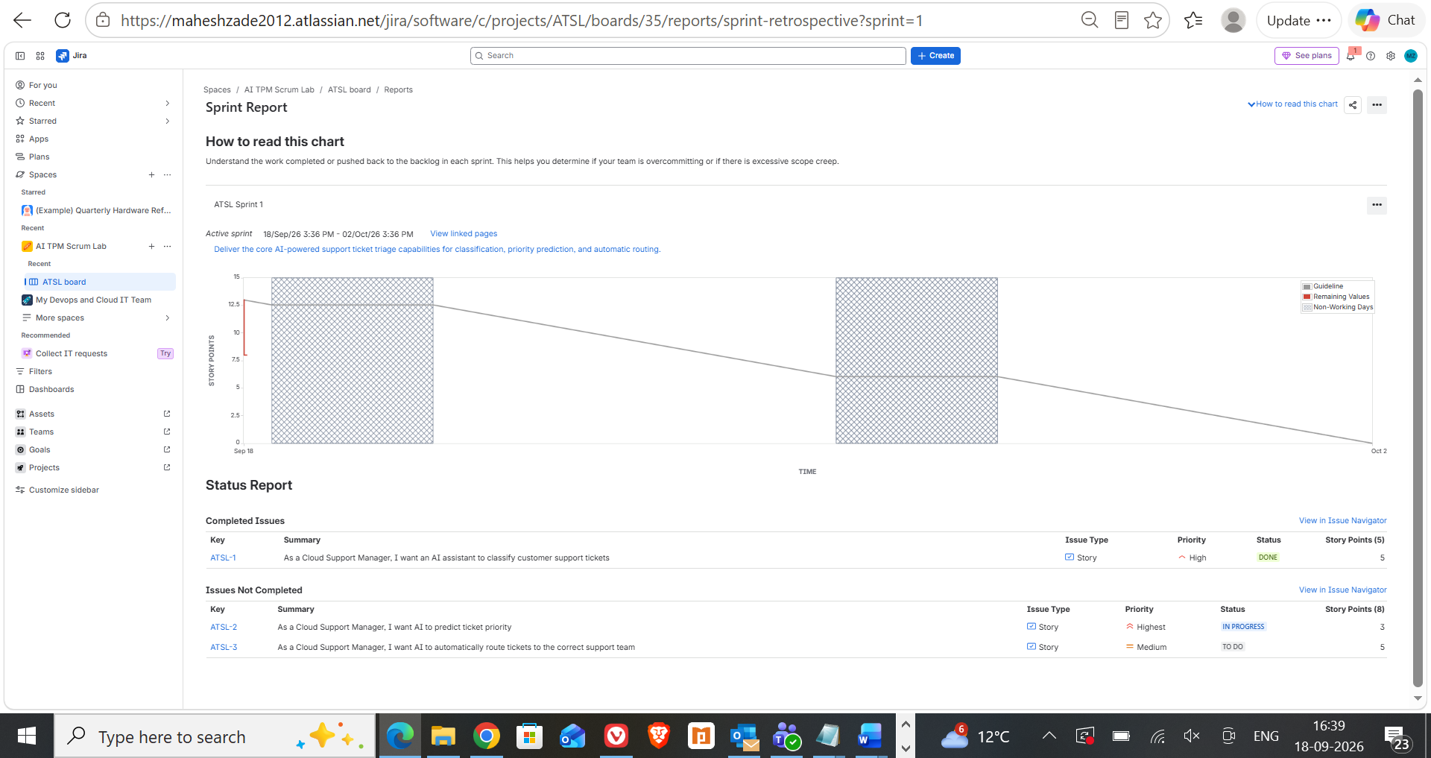
Evidence 13 — Jira Screenshot Archive
SCREENSHOT EVIDENCE
evidence_035
evidence_036
AI TPM / Jira Delivery Project • Prepared by Mahesh Zade
48

Slide 49
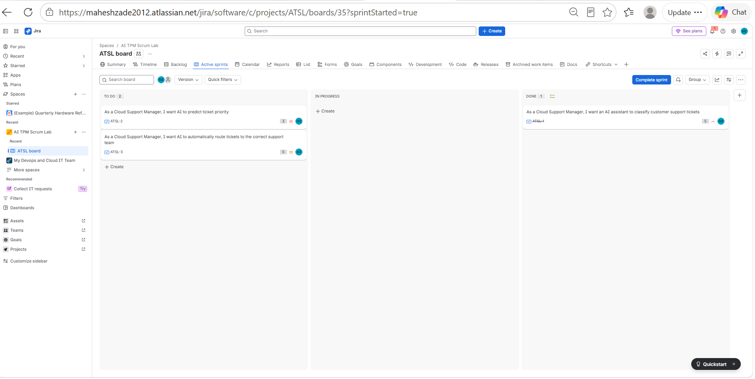
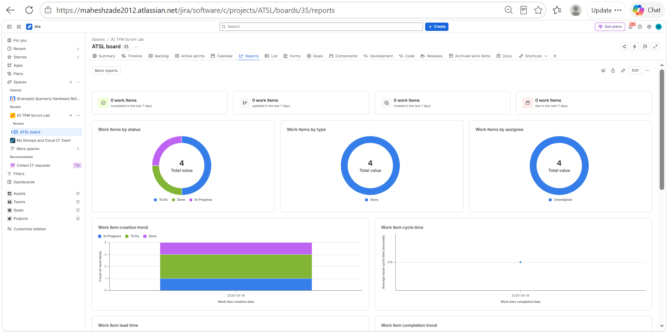
Evidence 14 — Jira Screenshot Archive
SCREENSHOT EVIDENCE
evidence_037
evidence_038
AI TPM / Jira Delivery Project • Prepared by Mahesh Zade
49

Slide 50
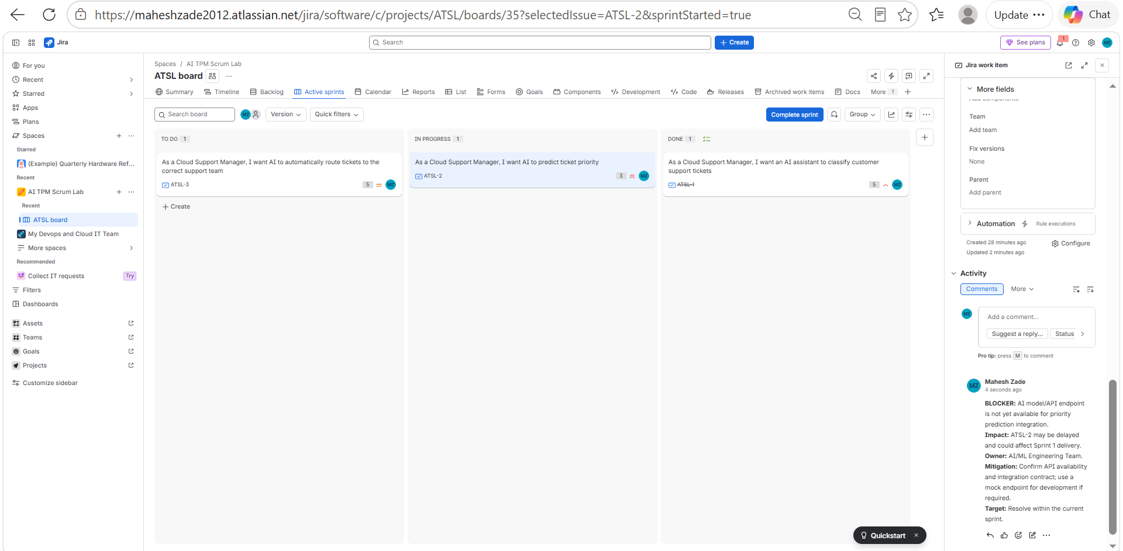
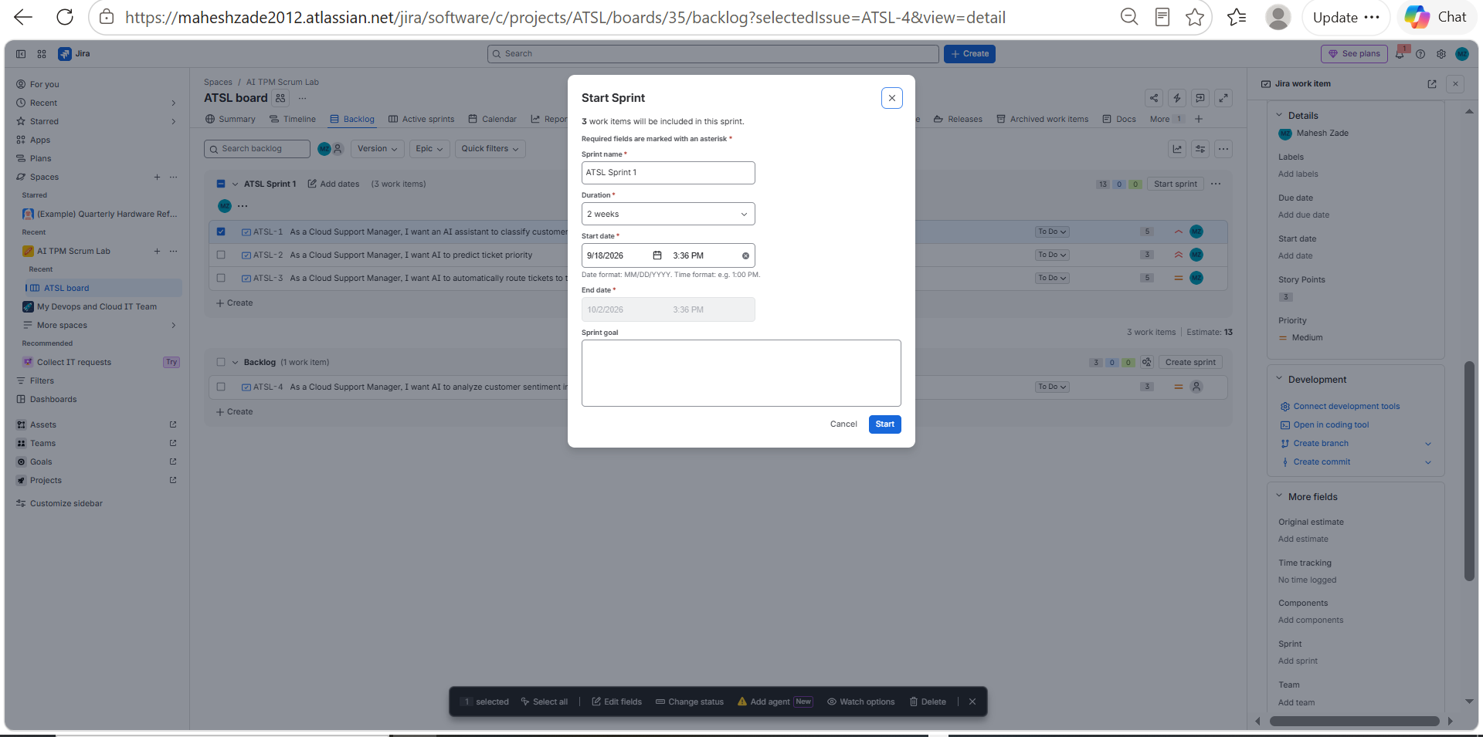
Evidence 15 — Jira Screenshot Archive
SCREENSHOT EVIDENCE
evidence_039
evidence_040
AI TPM / Jira Delivery Project • Prepared by Mahesh Zade
50

Slide 51
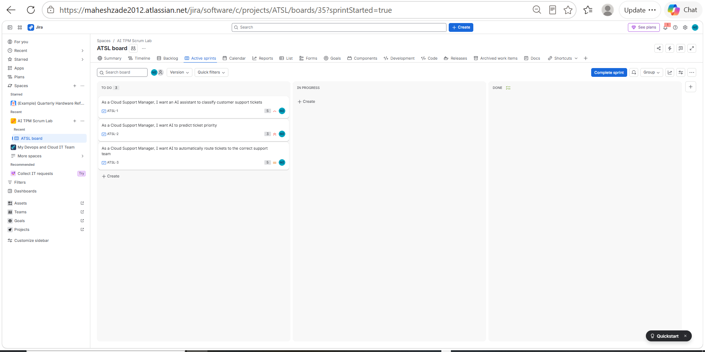
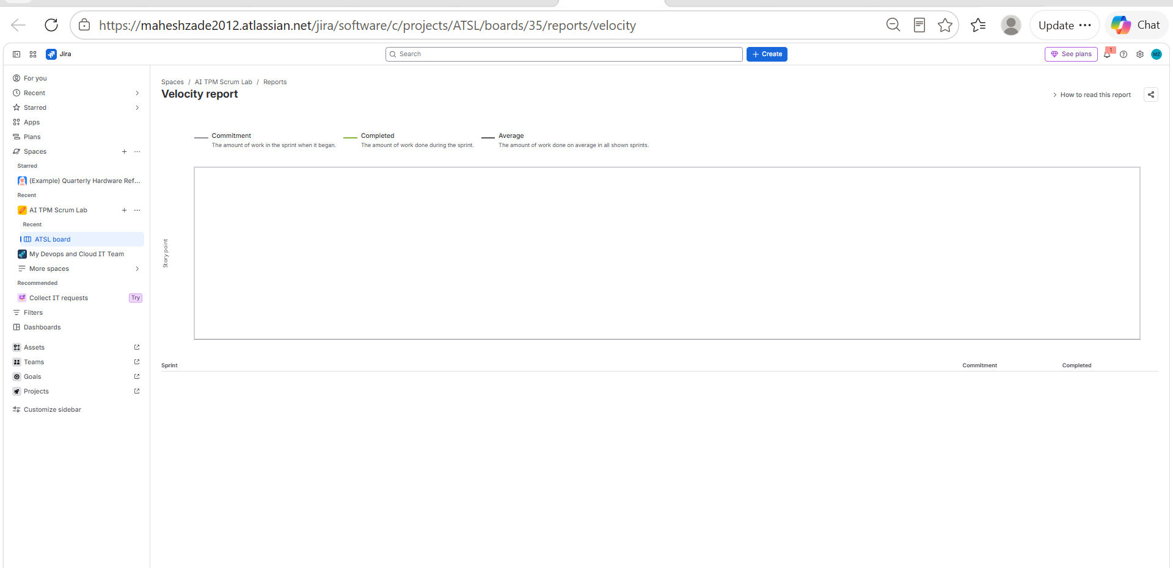
Evidence 16 — Jira Screenshot Archive
SCREENSHOT EVIDENCE
evidence_041
evidence_042
AI TPM / Jira Delivery Project • Prepared by Mahesh Zade
51

Slide 52
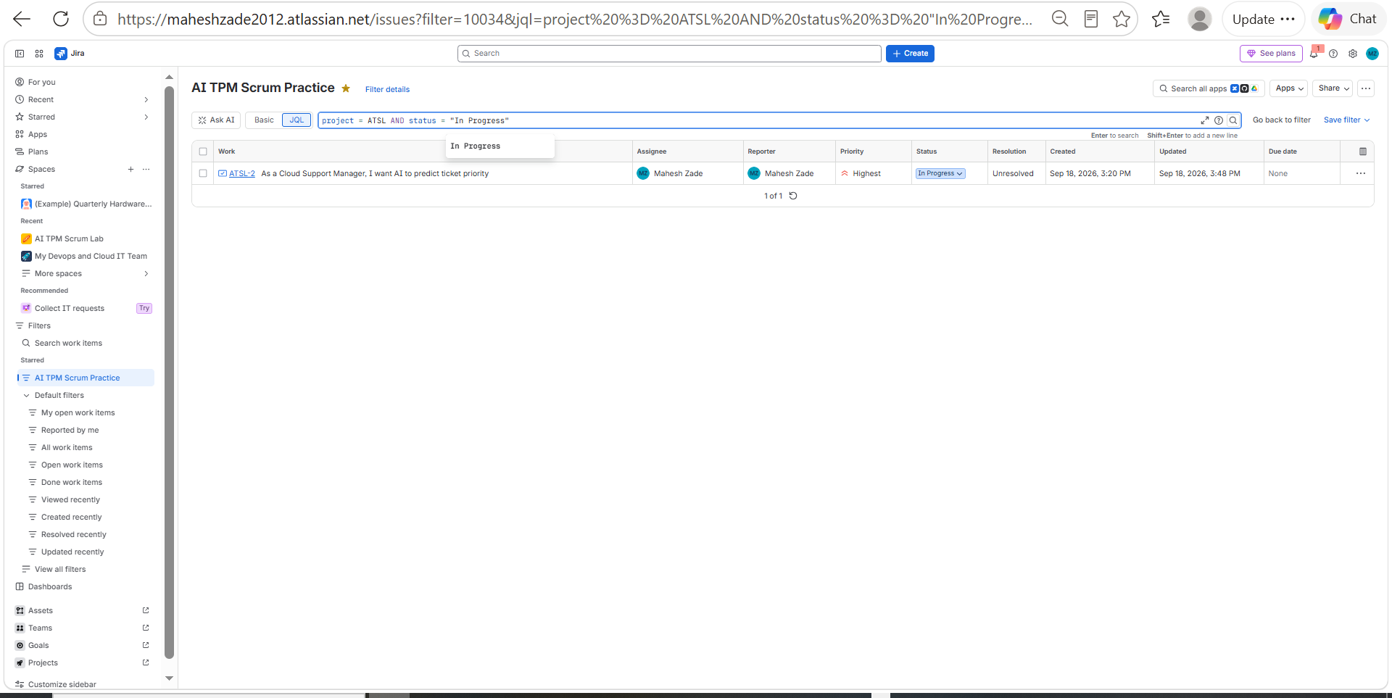
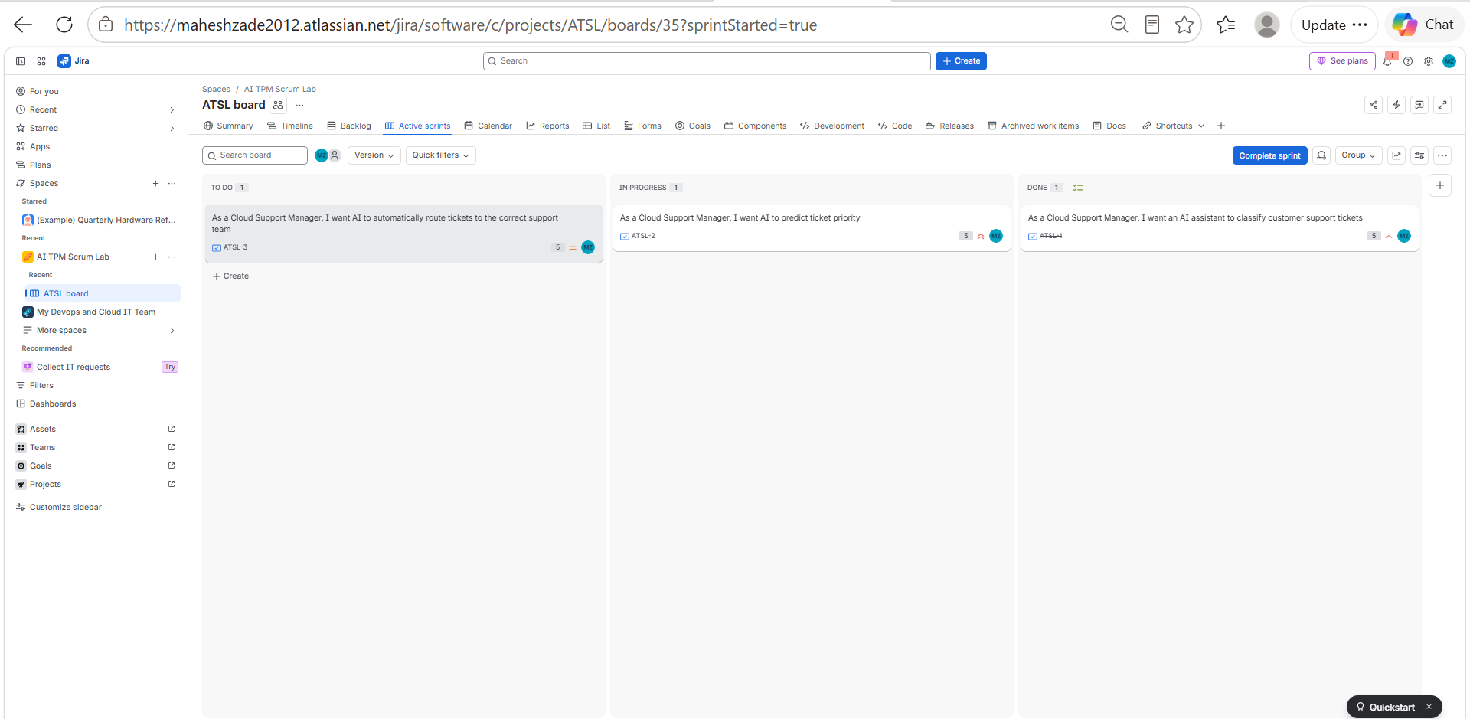
Evidence 17 — Jira Screenshot Archive
SCREENSHOT EVIDENCE
evidence_043
evidence_044
AI TPM / Jira Delivery Project • Prepared by Mahesh Zade
52

Slide 53
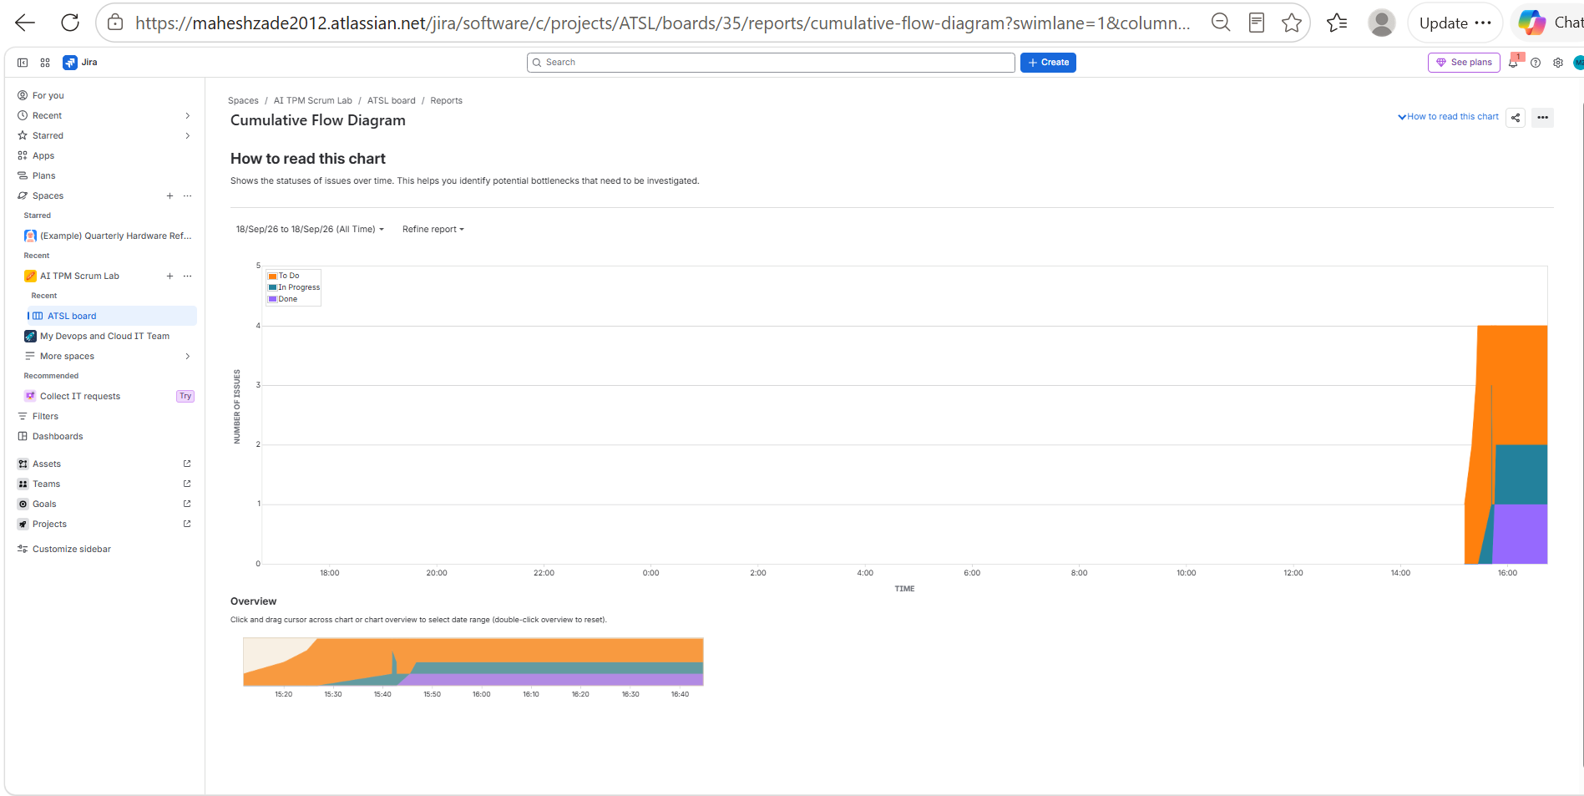
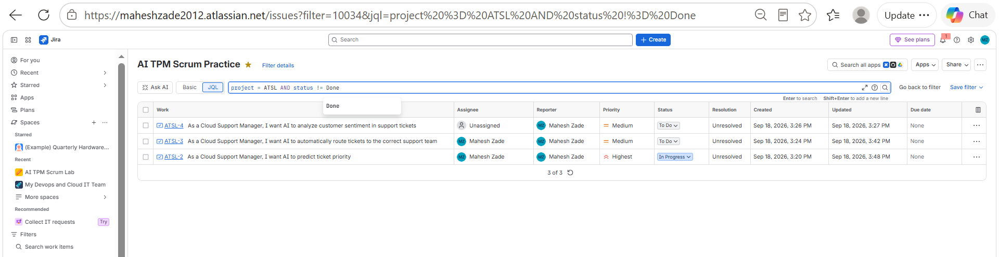
Evidence 18 — Jira Screenshot Archive
SCREENSHOT EVIDENCE
evidence_045
evidence_046
AI TPM / Jira Delivery Project • Prepared by Mahesh Zade
53

Slide 54
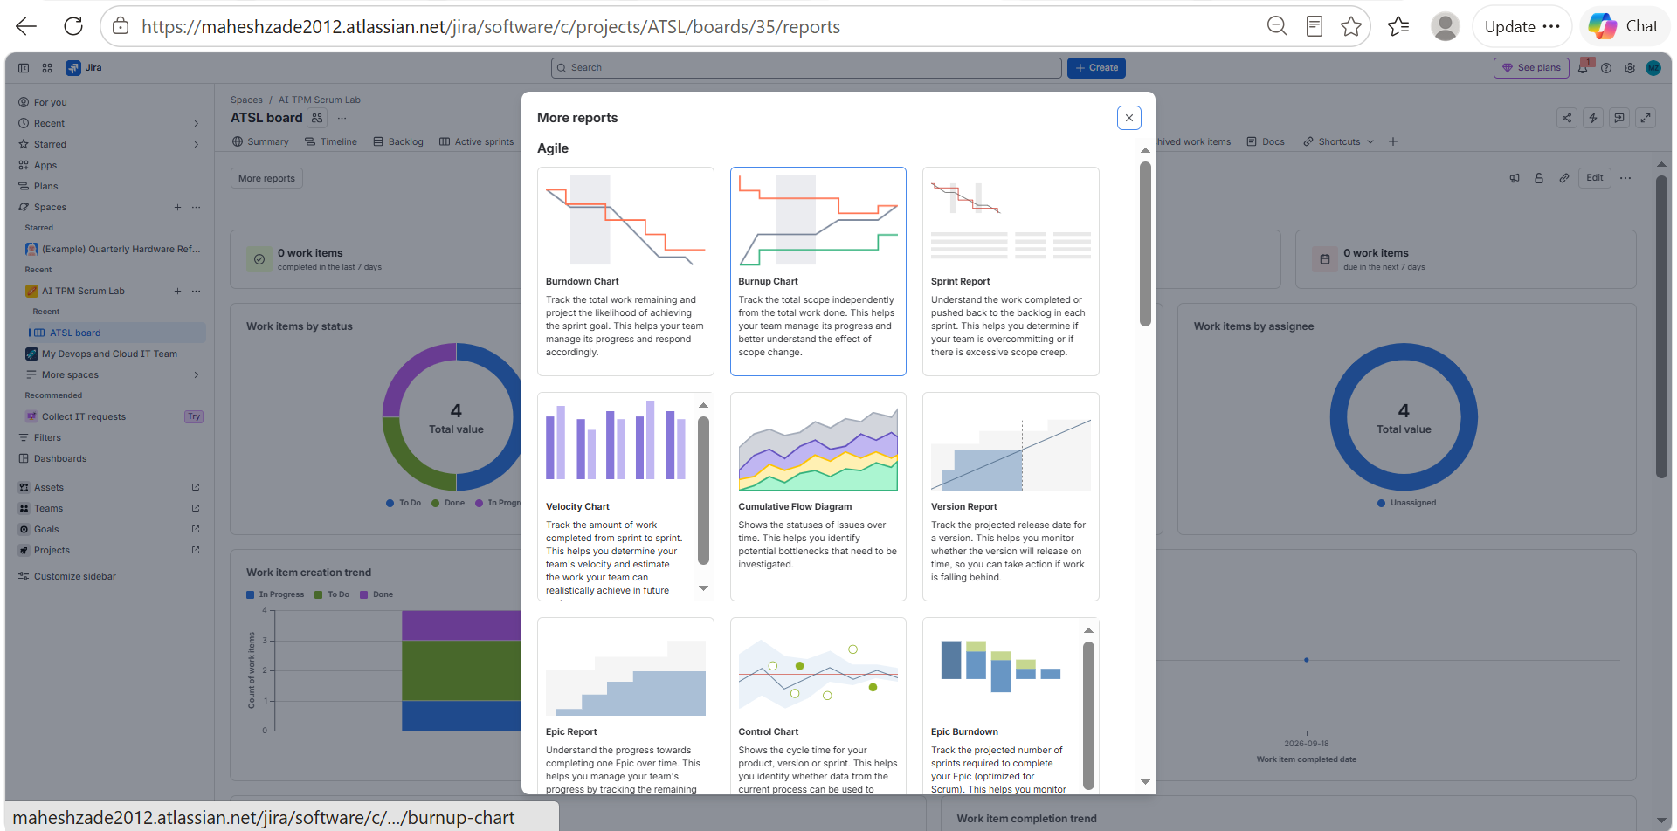
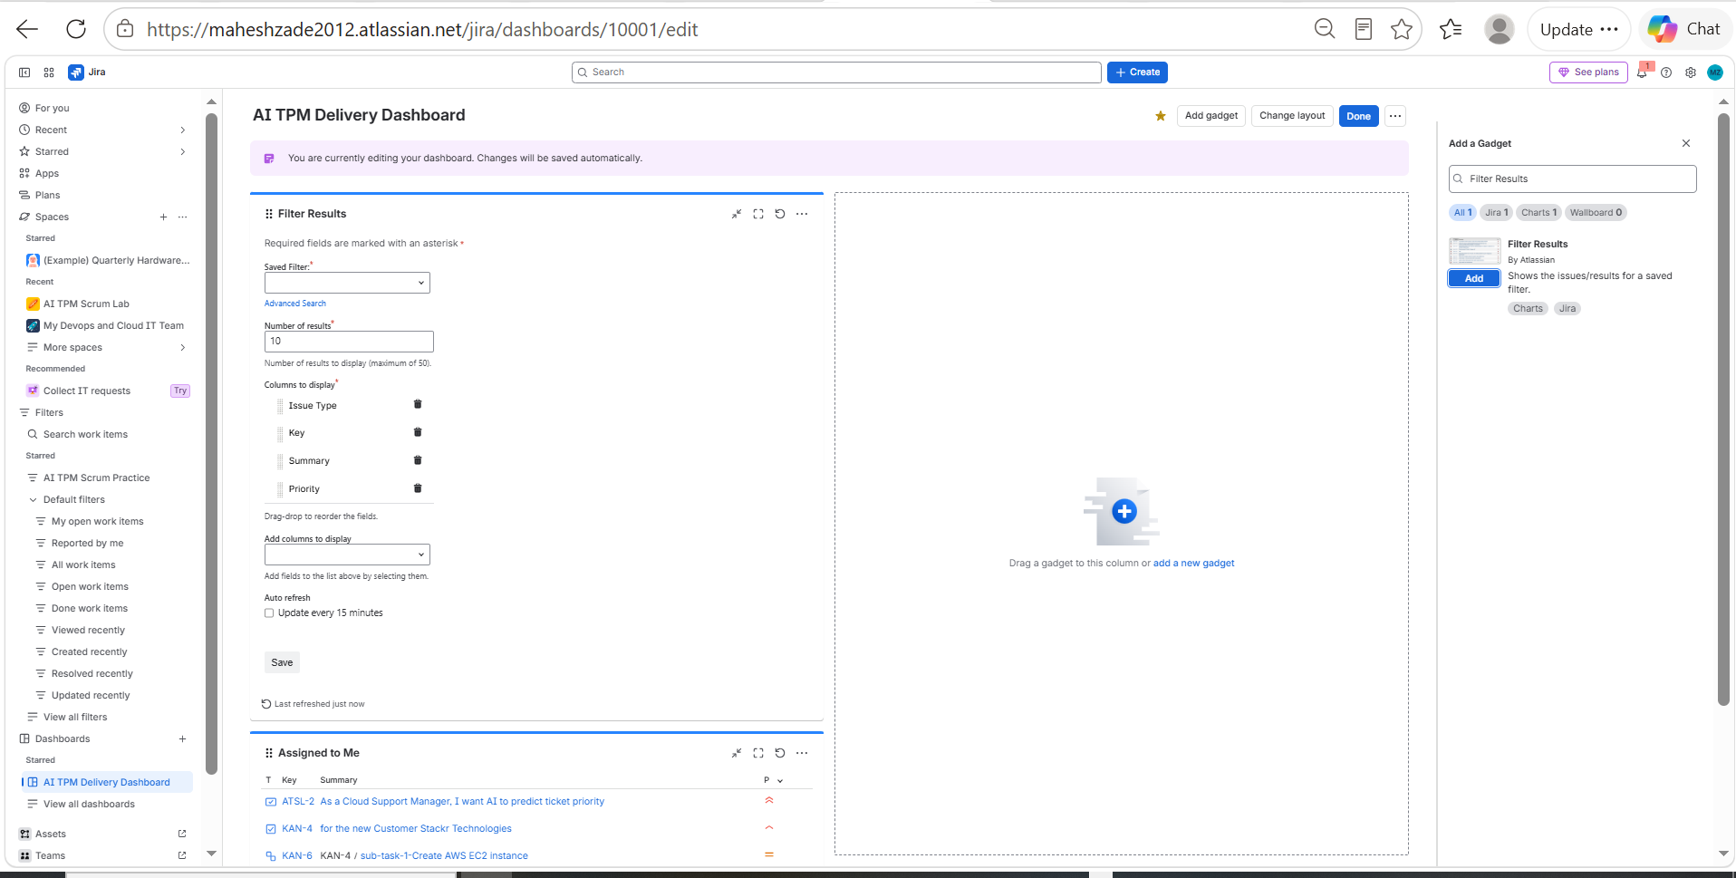
Evidence 19 — Jira Screenshot Archive
SCREENSHOT EVIDENCE
evidence_047
evidence_048
AI TPM / Jira Delivery Project • Prepared by Mahesh Zade
54

Slide 55
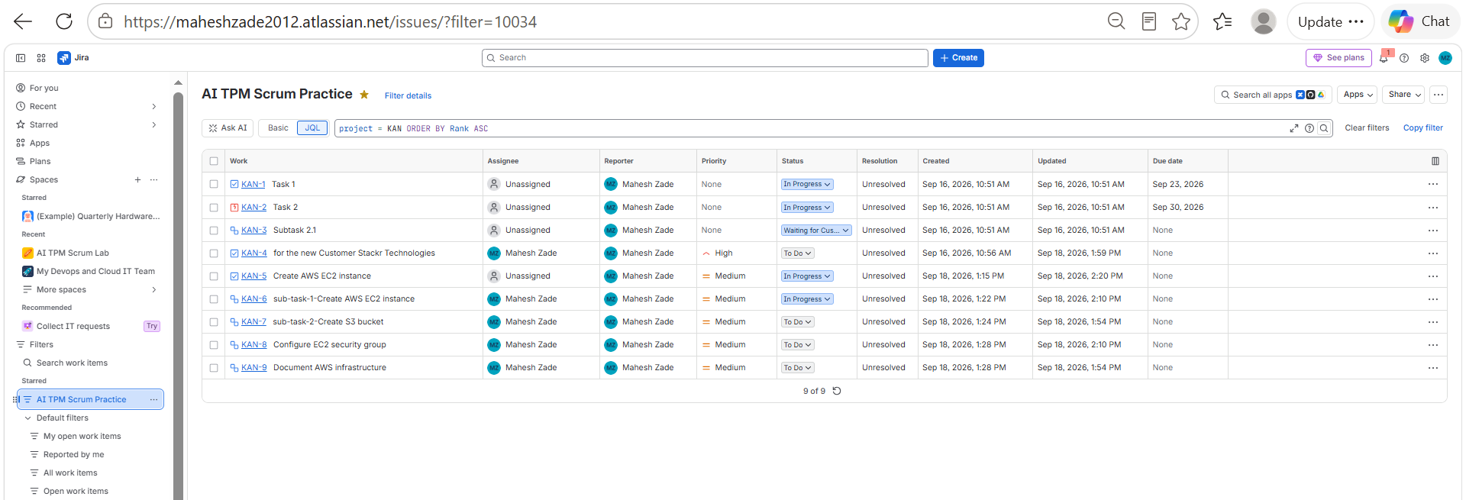
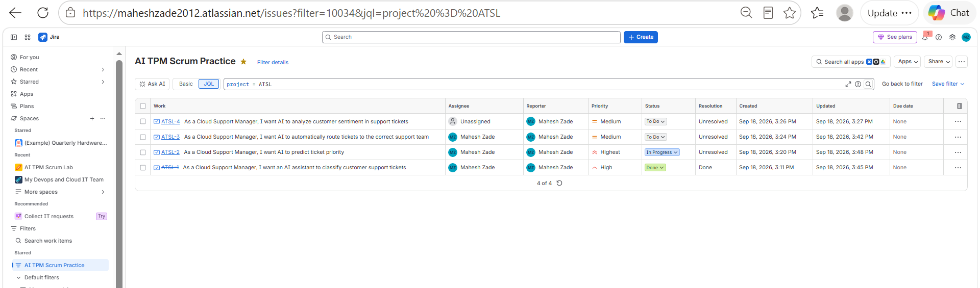
Evidence 20 — Jira Screenshot Archive
SCREENSHOT EVIDENCE
evidence_049
evidence_050
AI TPM / Jira Delivery Project • Prepared by Mahesh Zade
55

Slide 56


Evidence 21 — Jira Screenshot Archive
SCREENSHOT EVIDENCE
evidence_051
evidence_052
AI TPM / Jira Delivery Project • Prepared by Mahesh Zade
56

Slide 57


Evidence 22 — Jira Screenshot Archive
SCREENSHOT EVIDENCE
evidence_053
evidence_054
AI TPM / Jira Delivery Project • Prepared by Mahesh Zade
57

Slide 58


Evidence 23 — Jira Screenshot Archive
SCREENSHOT EVIDENCE
evidence_055
evidence_056
AI TPM / Jira Delivery Project • Prepared by Mahesh Zade
58

Slide 59


Evidence 24 — Jira Screenshot Archive
SCREENSHOT EVIDENCE
evidence_057
evidence_058
AI TPM / Jira Delivery Project • Prepared by Mahesh Zade
59

Slide 60


Evidence 25 — Jira Screenshot Archive
SCREENSHOT EVIDENCE
evidence_059
evidence_060
AI TPM / Jira Delivery Project • Prepared by Mahesh Zade
60

Slide 61


Evidence 26 — Jira Screenshot Archive
SCREENSHOT EVIDENCE
evidence_061
evidence_062
AI TPM / Jira Delivery Project • Prepared by Mahesh Zade
61

Slide 62


Evidence 27 — Jira Screenshot Archive
SCREENSHOT EVIDENCE
evidence_063
evidence_064
AI TPM / Jira Delivery Project • Prepared by Mahesh Zade
62

Slide 63


Evidence 28 — Jira Screenshot Archive
SCREENSHOT EVIDENCE
evidence_065
evidence_066
AI TPM / Jira Delivery Project • Prepared by Mahesh Zade
63

Slide 64


Evidence 29 — Jira Screenshot Archive
SCREENSHOT EVIDENCE
evidence_067
evidence_068
AI TPM / Jira Delivery Project • Prepared by Mahesh Zade
64

Slide 65


Evidence 30 — Jira Screenshot Archive
SCREENSHOT EVIDENCE
evidence_069
evidence_070
AI TPM / Jira Delivery Project • Prepared by Mahesh Zade
65

Slide 66


Evidence 31 — Jira Screenshot Archive
SCREENSHOT EVIDENCE
evidence_071
evidence_072
AI TPM / Jira Delivery Project • Prepared by Mahesh Zade
66

Slide 67


Evidence 32 — Jira Screenshot Archive
SCREENSHOT EVIDENCE
evidence_073
evidence_074
AI TPM / Jira Delivery Project • Prepared by Mahesh Zade
67

Slide 68


Evidence 33 — Jira Screenshot Archive
SCREENSHOT EVIDENCE
evidence_075
evidence_076
AI TPM / Jira Delivery Project • Prepared by Mahesh Zade
68

Slide 69


Evidence 34 — Jira Screenshot Archive
SCREENSHOT EVIDENCE
evidence_077
evidence_078
AI TPM / Jira Delivery Project • Prepared by Mahesh Zade
69

Slide 70


Evidence 35 — Final Dashboard & Closing Evidence
SCREENSHOT EVIDENCE
evidence_079
evidence_080_final_dashboard
AI TPM / Jira Delivery Project • Prepared by Mahesh Zade
70

